Slide 1
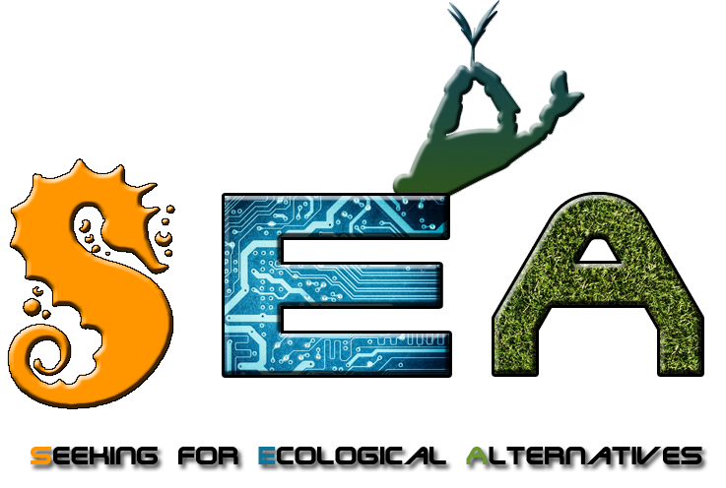



KA 229 School Exchange Partnership
2019-2021

Slide 2
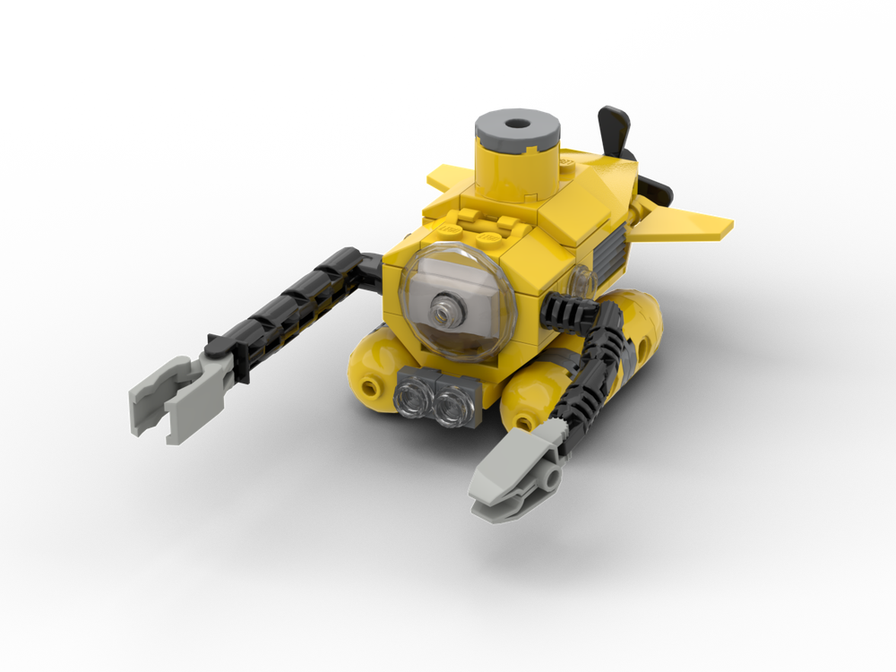
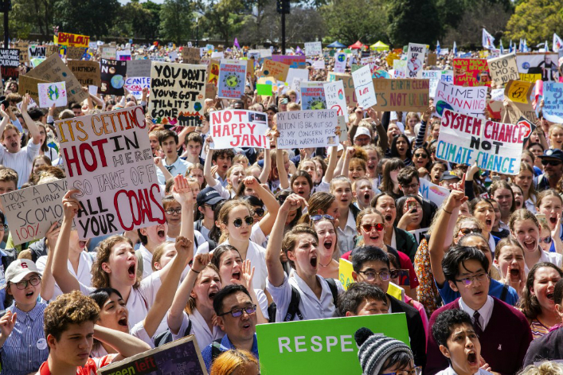
WHY ?
At the beginning SEA was a pure STEM project between two schools.
We wanted to build a hydrobot - submarine to take measurements in the Mediterranean and the North Sea.
But during this time young people all around the world begun to demonstrate for the climate.

Slide 3
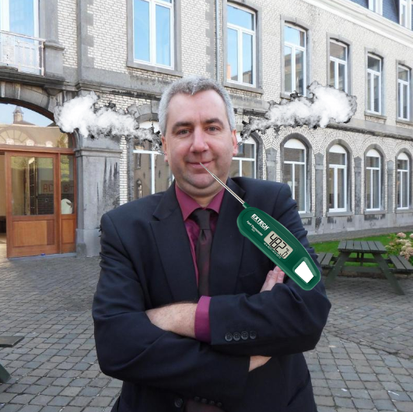
WHY ?
This situation has sometimes been difficult to manage for some headteachers.
That’s why we decided to make of SEA an opportunity for them to act and express themselves.
Not the headteachers... the students!!!

Slide 4


WHO ?
20 STEM students of the 2d Lyceum of Kalamaria
In Champion 20 students of the 3d year STEM class are involved...
... but 17 other students from the 4d year STEM class will also participate.

Slide 5
Main targets
The creation of a submarine robot will engage our students in a process of intergenerational and international collaboration, encourage their investment, cooperation and empowerment.
The "STEM" will also be responsible for conducting research and will regularly communicate the results to their peers (blog, social networks, website, posters, newsletters, etc.).
Discussions will be organized to maintain a common reflection on the implementation of at least three concrete resolutions in favor of ecology and climate. (democratic decision-making process)
Organize and participate to temporary actions: conferences, awareness actions, etc.

Slide 6
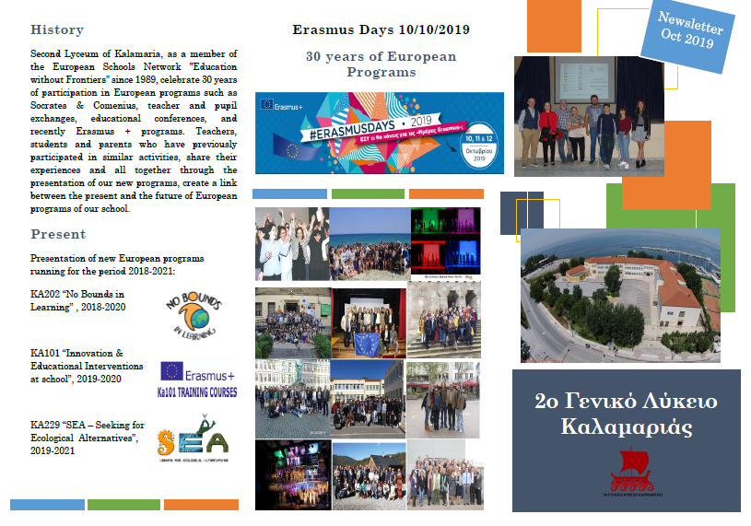
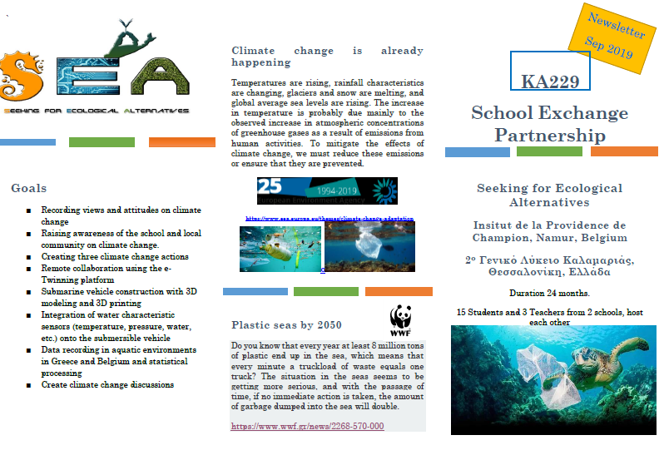
What’s already done ?
4 newsletters have already be written.
A large survey has been proposed to our students and their parents to make an initial assessment: what do they know about what has already been done, what should we do next?
The project was presented during Erasmus + days in Greece.
Students prepare for their first workshop to be held in Namur in January.

Slide 7
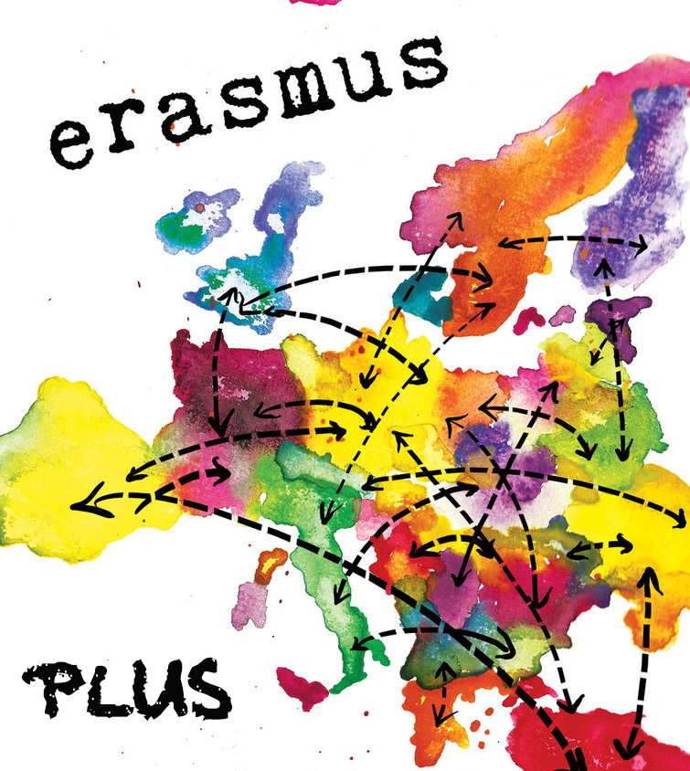
Questions ?

