Slide 2
European Youth:
Values, Identity, Culture

Slide 3
KA229 – Exchange of Good Practices

Slide 4
... To raise awareness of the divers cultures/values/identities as parts of European values...
...to weigh up the benefits and challenges of the European Union...
...to reflect critically on Europe’s past, present and future...

Slide 5
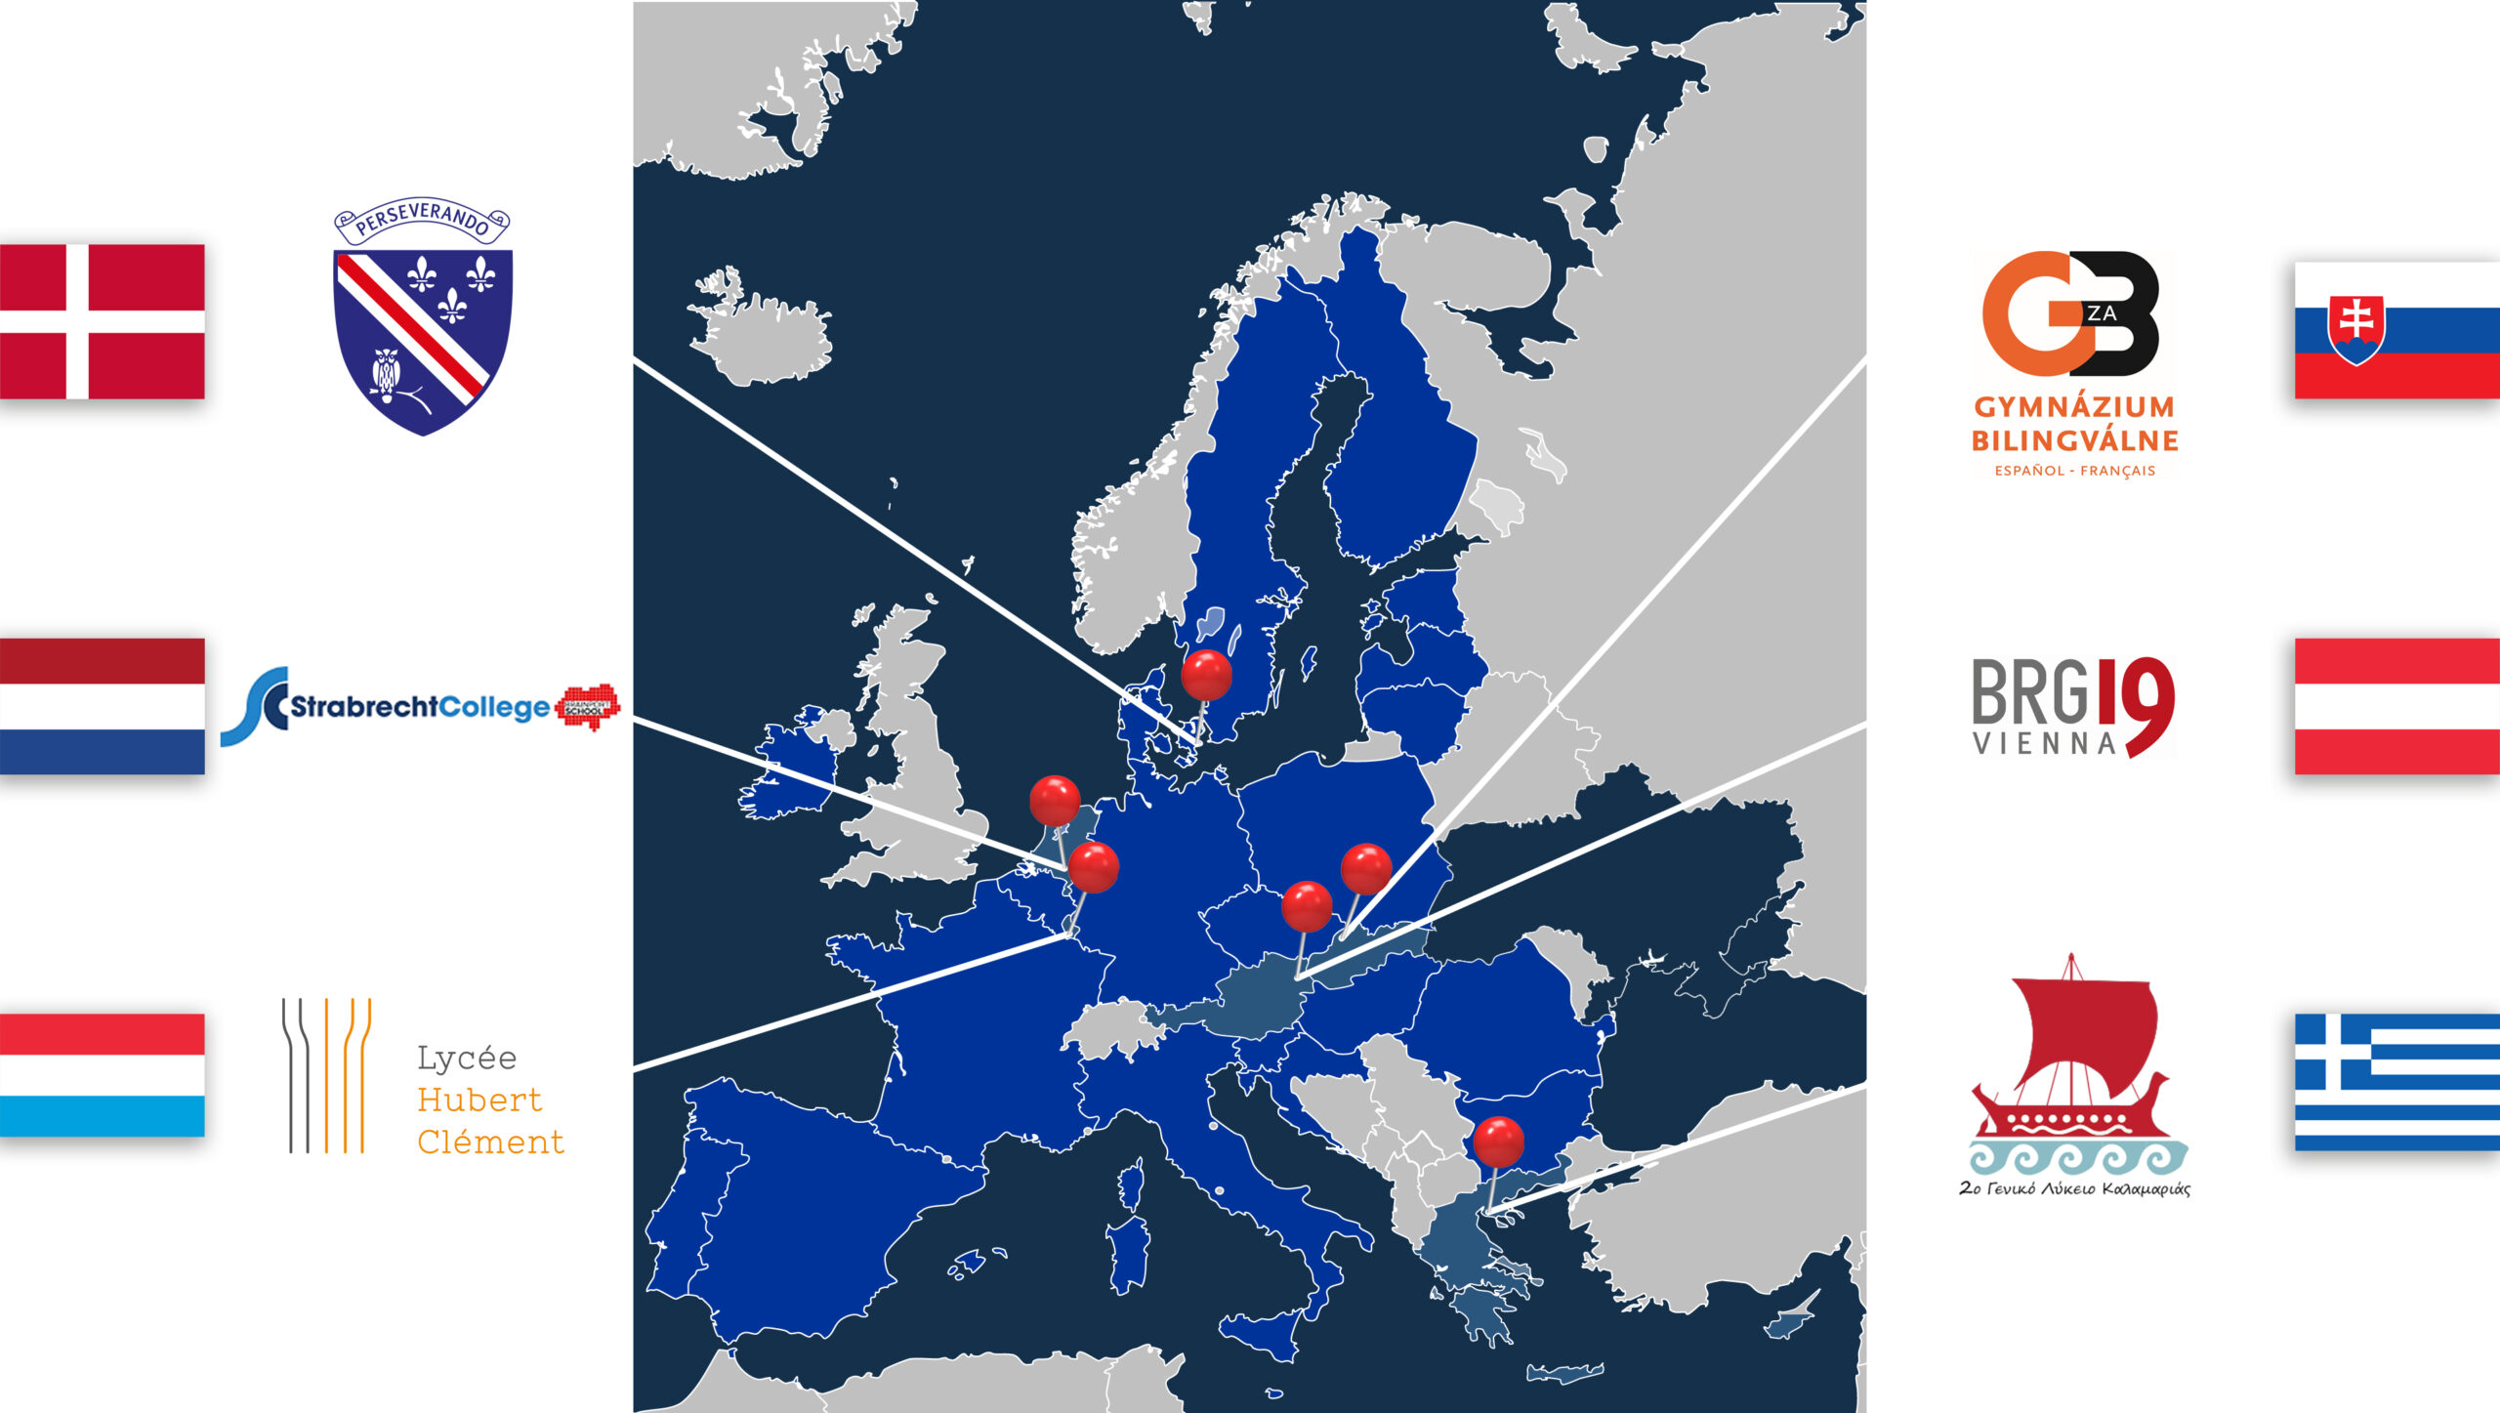
Spring 2023
March 2022
October 2022
Virtual kick-off conference
2.We are europe[ans]! Does a European identity exist in our students‘ minds?
3.IS there still a Awareness of basic European Values? What about a cultural european identity?
4.How to communicate our common european values and history?

Slide 6
Thank you for your attention!

