Slide 1




ERASMUS+ KA2 project
EWF – Education without frontiers
2019 – 2022 – 3 schools 3 years – long-term study mobilities , joint staff training events
GBZA
IES Miguel Catalán
SCHILDTIN LUKIO

Slide 2




Best practices, TESTIMONIES, experiences from:
Gymnázium bilingválne žilina, IES Miguel catalán zaragoza, schildtin lukio Jyväskylä
https://twinspace.etwinning.net/96896/pages/page/1080657
Mobilities:
2-months for students,1week for teachers
ES – 8 students, 5 teachers
FI – 6 students, 4 teachers
SK – 10 students, 3 teachers
+ a lot of local participants
https://sk.padlet.com/jankamladenkova/88p1ytjdac8mqvcc

Slide 3
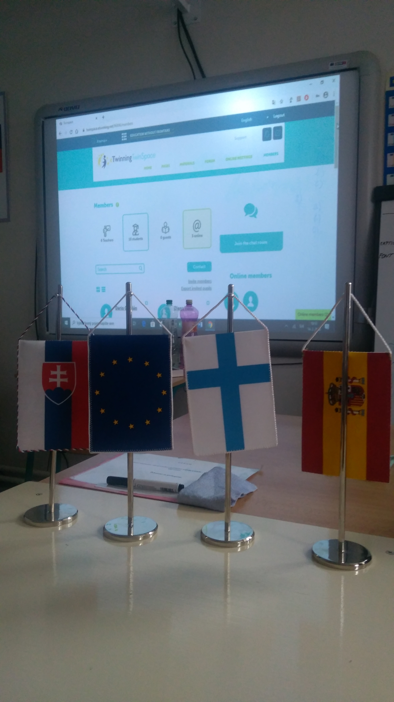
Project outcome and results:
improved language and digital competences, social skills
raised cultural awareness
strengthened cooperation between schools
portfolio of teaching methods including integration of foreign students
practical tips for mobility organisation

Slide 4

Thank you for your attention
janka.mladenkova@gbza.eu
satu.syyrakki@gradia.fi
lmegino@ies-mcatalan.com

