Slide 1
Network conference
Esch-sur-Alzette (Luxembourg)
25.10. – 29.10.2022

Slide 2
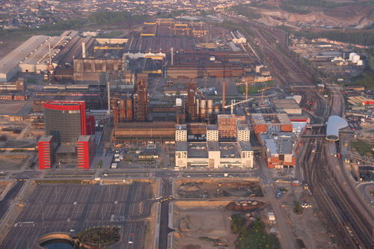
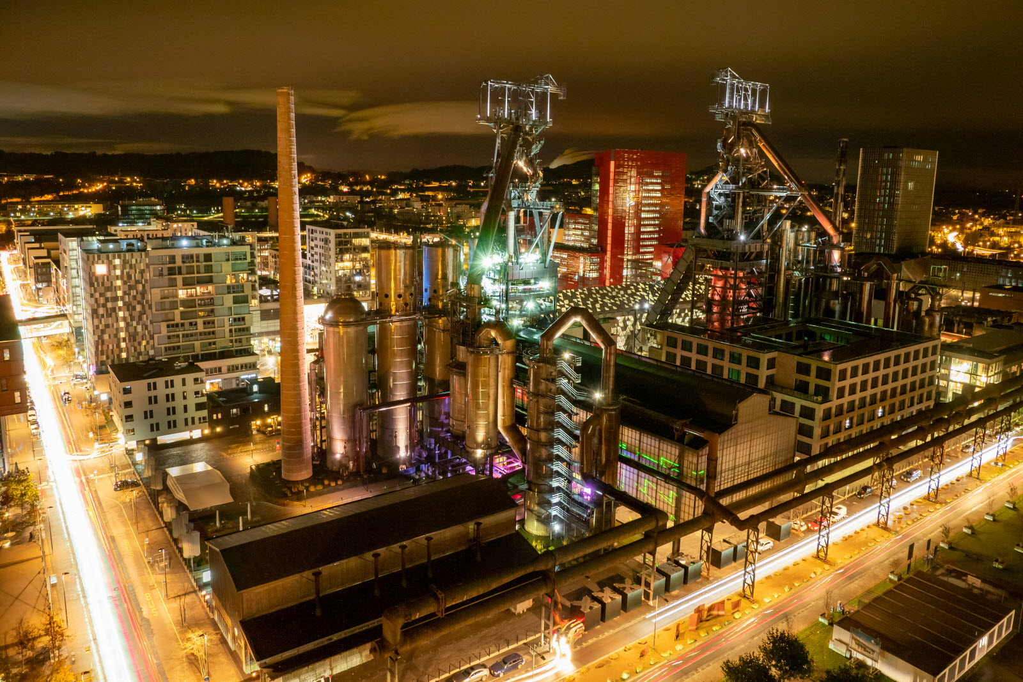
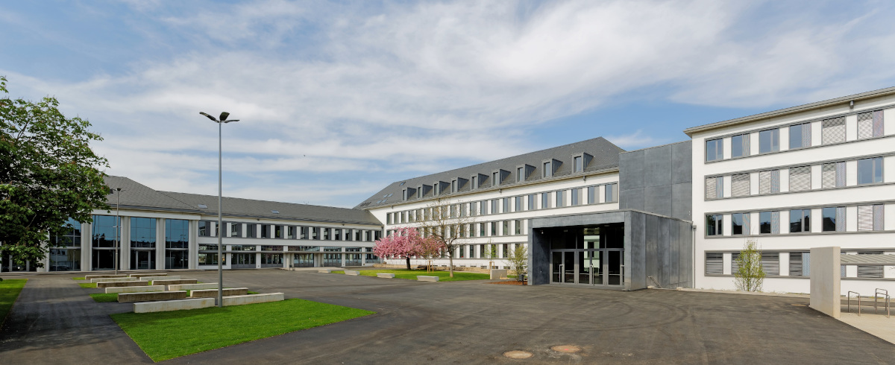
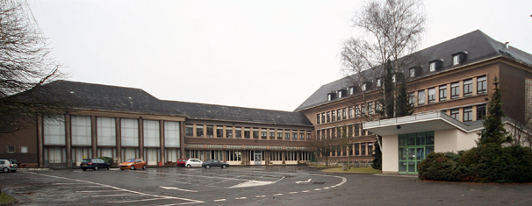
Welcome to Esch

Slide 3
European Youth
Values – Identity - Culture

Slide 4
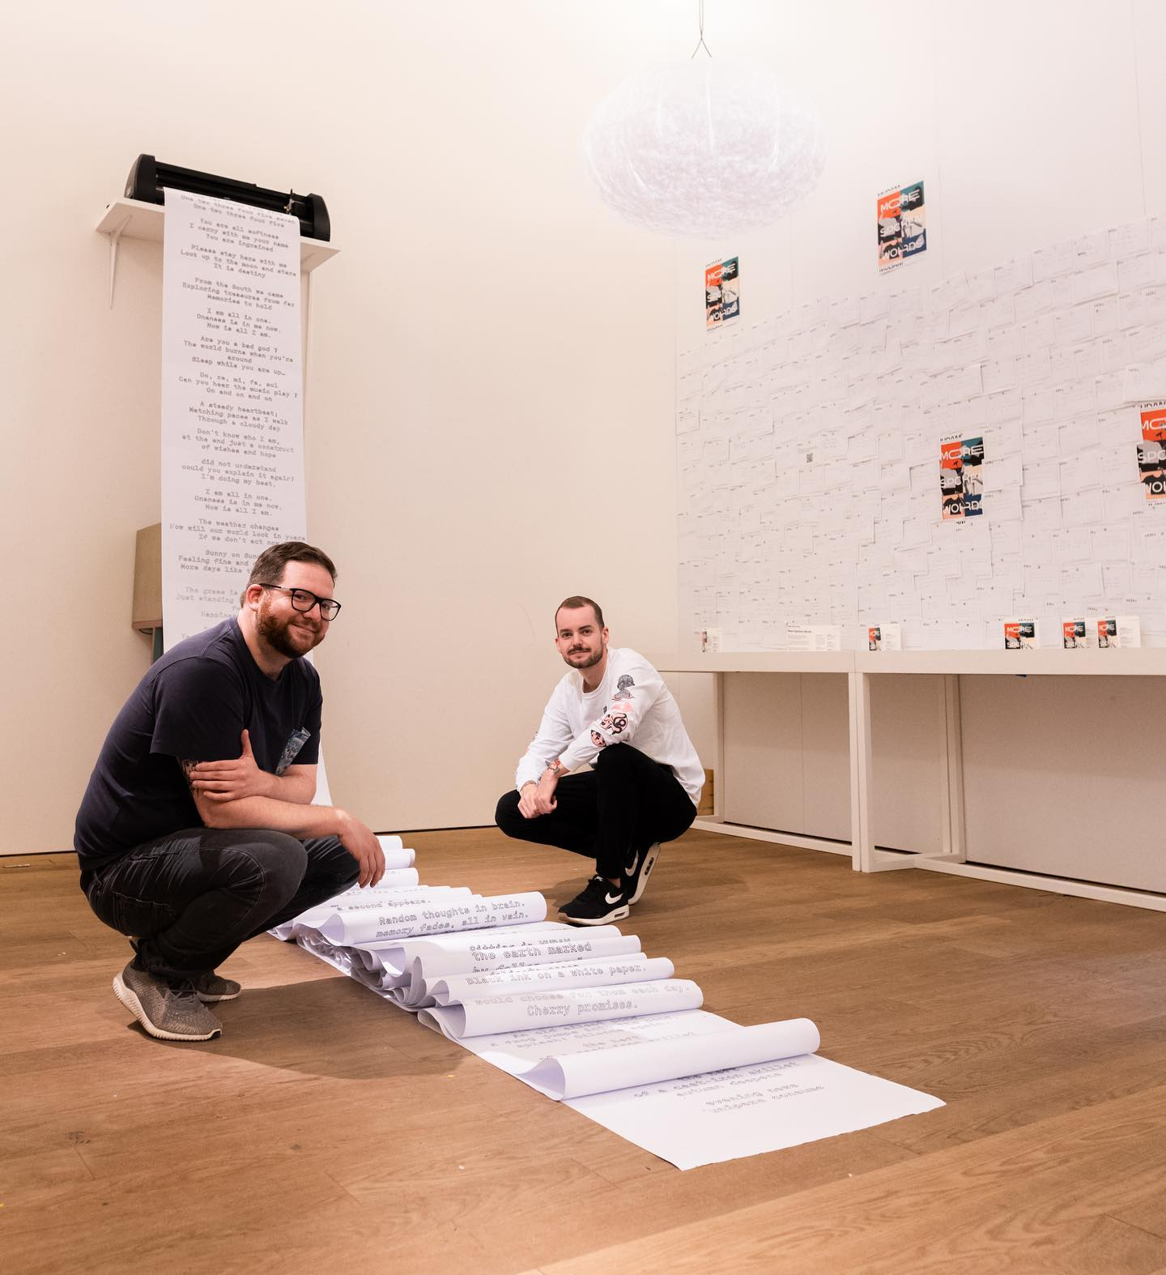
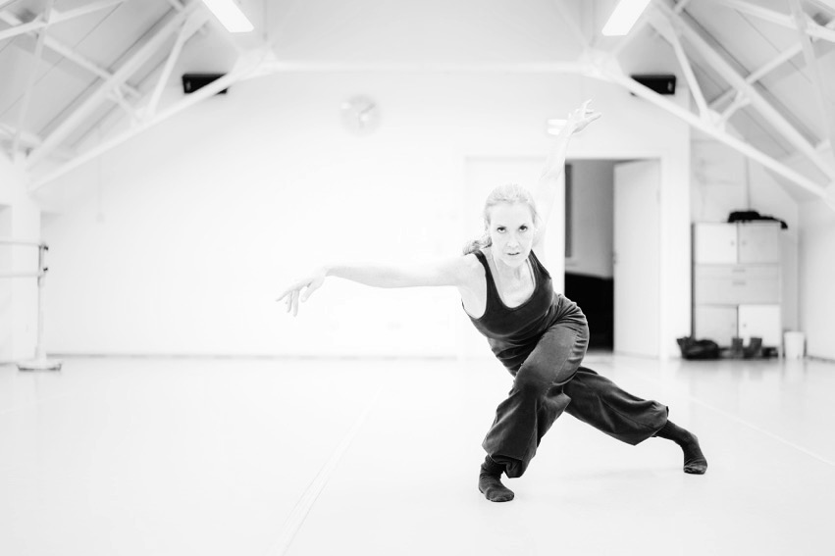
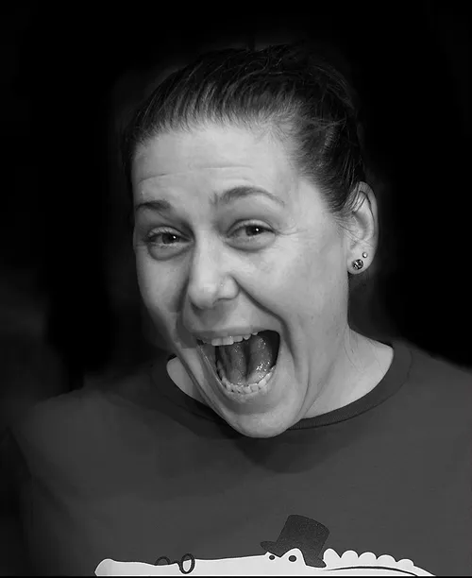
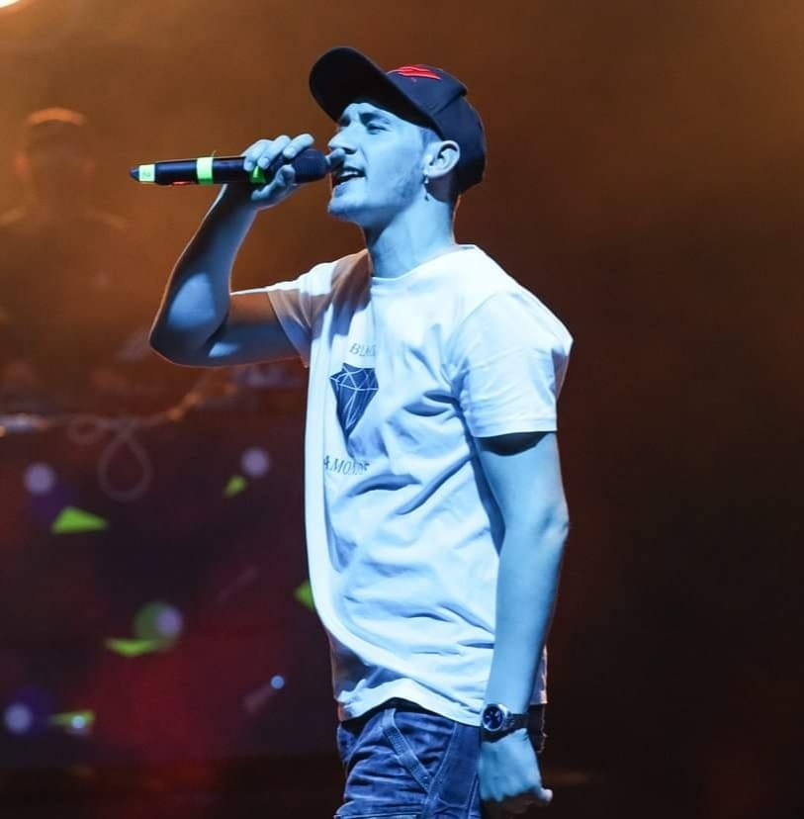
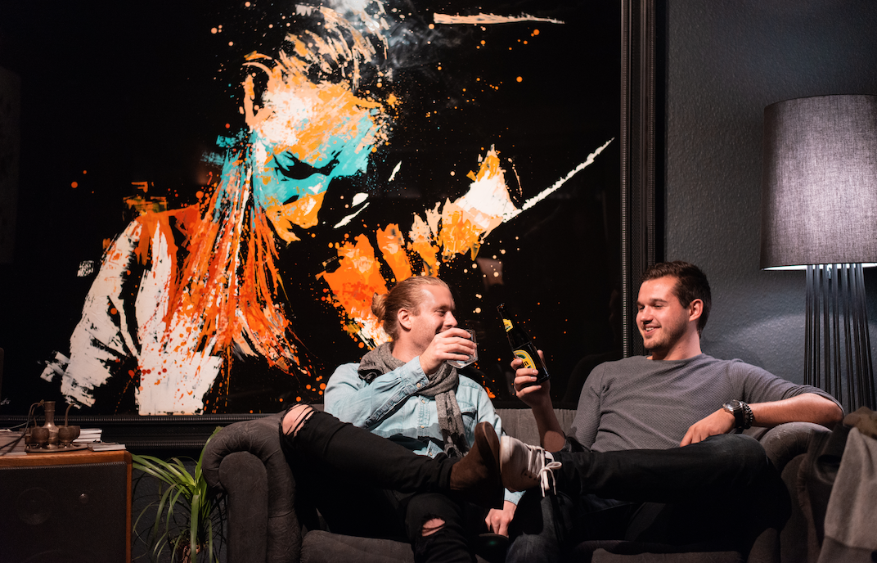
Workshops
Improtheatre
Poetryslam
Streetart
Dance
Hip Hop

Slide 5
- 2 students (16-18 years) staying in hostfamilies
- Every student makes a choice of 2 workshops (first/second choice)
- Students from one school pick different workshops
- No previous knowledge is necessary

Slide 6
Accomodation (Teachers)
The Belval district
‚Where the past is remixed with the future'
Hotel Ibis * * *

Slide 7
Participation fee:
Single room 550€ per person
Double room 400€ per person

Slide 8
See you in Esch...
...where Europe happens!

