Slide 1
E@NEWS 2017-2019
KA2 – Cooperation for Innovation and the Exchange of Good Practices

Slide 2
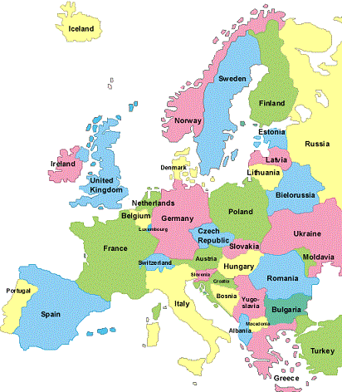
7 partner schools from…
The Czech Republic
Germany
Italy
the Netherlands
Norway
The Republic of Ireland
Turkey
20 teachers +
150/200 students each year

Slide 3
FOCUS ON
JOURNALISM AND MASS MEDIA
RESPONSIBLE USE OF SOCIAL MEDIA
MEDIA ETHICS
INNOVATIVE WRITING AND VIDEO PRODUCTION

Slide 4
Aims:
getting to know each other and promoting awareness of our European identity
cooperating for innovation (new teaching and learning methods)
exchanging useful information and good practices
developing professional skills in the field of journalism and social media
enhancing the students’ competences (language, study and ICT skills)
final product: the creation of a European magazine

Slide 5
An innovative approach - used both by teachers and students
innovative ways of collaborating between peers – on eTwinning and TwinSpace
innovative learning environment - use of technologies, of Interactive Whiteboards in every classroom and of the flipped classroom methodology
innovative use of I.T. - the Internet, different computer programs (PowerPoint and Prezi presentations), WebQuests, YouTube videos, online newspapers, virtual classrooms, etc.
use of several media - videos, written and oral interviews, newspaper articles, drawing, etc.
peer-to-peer teaching and CLIL lessons on Geography

Slide 6
Teachers’ meetings
November 2017 - the Netherlands
November 2018 – the Czech Republic
AIM: attending lectures and workshops from media professionals in the field of visual and audio media and new communicational strategies to pass on to the students back at home

Slide 7
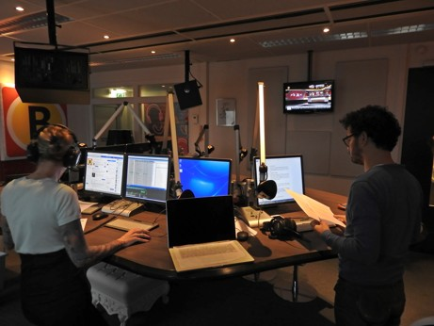
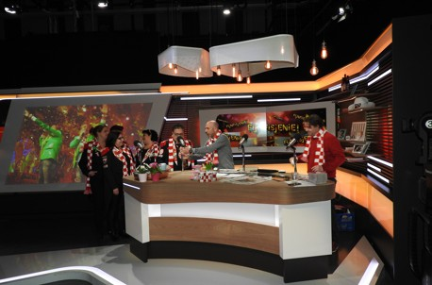
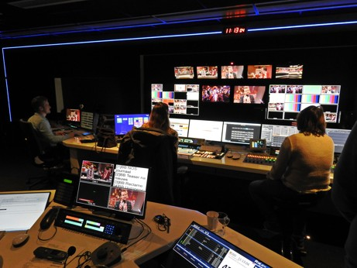
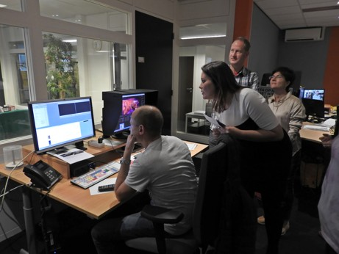

Slide 8
Students working on Twinspace
1ST STEP:
PERSONAL PRESENTATIONS / INTERVIEWS
AIM: to stimulate communication between peers

Slide 9
Students working on Twinspace
2ND STEP:
NATIONAL ARTICLES / VIDEOS
AIM: to use the methodology acquired to write articles and create videos about national topics (important people, entrepreneurship, environment, cultural events, sports, school issues)

Slide 10
Students working on Twinspace
3RD STEP:
INTERNATIONAL REPORTS
AIM: to compare different cultures and create an international report, promoting the awareness of our European identity

Slide 11
Peer-to-peer teaching
Using what they learnt about the partner countries and the new methodologies acquired, the students prepare
CLIL lessons on Geography
to be taught to younger students of middle schools

Slide 12
Meeting in Norway – April 2018
WHO?
teachers and selected students as ambassadors
WHAT?
seminars on media ethics, the role of the media in modern society and media production
workshops on creative and innovative writing and video production
visits to media companies and organizations
WHY
to improve the quality of the students’ products, posted on eTwinning in the form of articles and videos (https://twinspace.etwinning.net/46526/pages/page/292601)

Slide 13
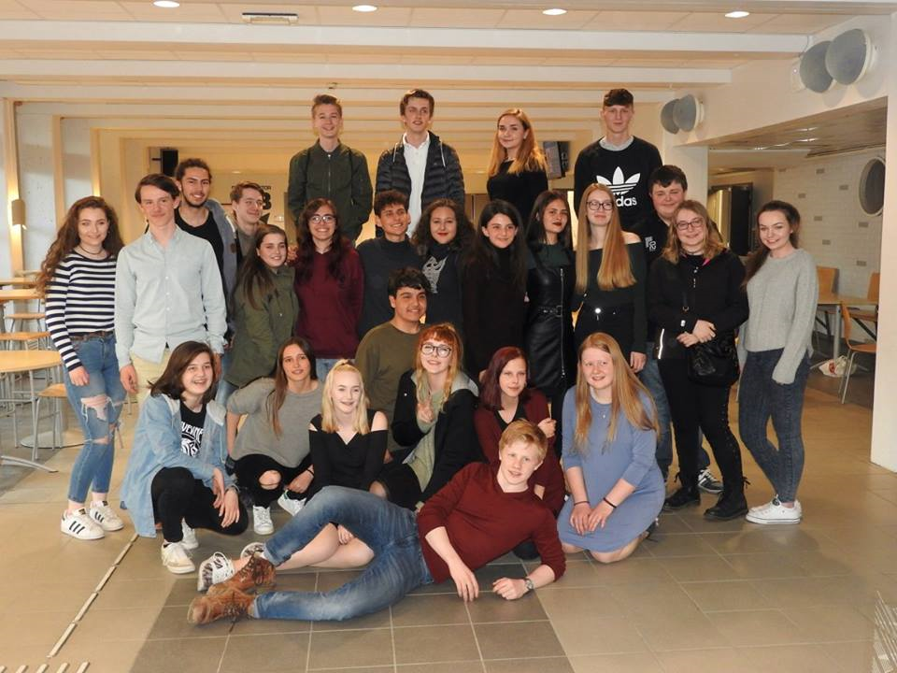
THE STUDENTS in Norway

Slide 14
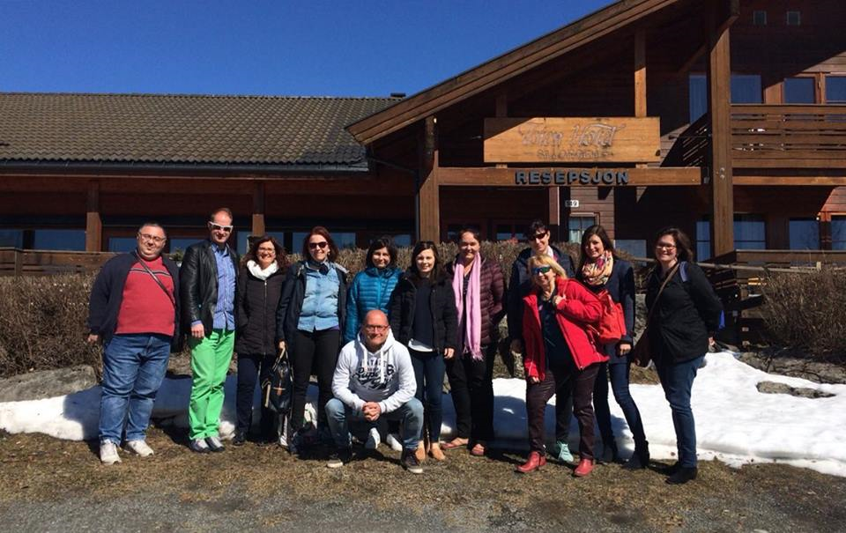
THE TEACHERS

Slide 15
Meeting in Italy – March 2019
final meeting of teachers and students
workshops, lectures and visits to media companies and organizations
the students, divided in mixed groups, will discuss some given topics and create international media products which will be assembled in an international newspaper or magazine

