Slide 1
K2 project HOPE
Human Opportunities for Peace in Europe –
Lifelong learning democracy and active citizenship

Slide 2
Key action 2: Cooperation for innovation and the exchange of good practices
Field: Strategic partnerships for schools only

Slide 3
Application handed in 03/2017
Approval from NA: July 2017
Project start 9/2017 27 months
End 30/11/2019

Slide 4
schools
LUXEMBOURG –Coordinator
GERMANY – Partner
SLOVAKIA - Partner
SPAIN – Partner
POLAND – Partner

Slide 5
The idea
1. Build on positive experiences and benefits from YEL
2. Define and expand the tasks
of the clubs!

Slide 6
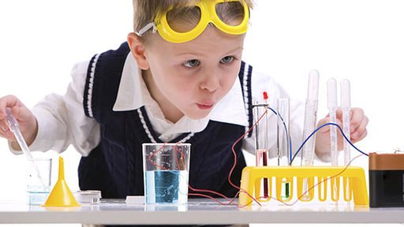
Challenge
From YEL to HOPE
Don’t copy, but be creative…
↓
We had to reinvent ourselves!

Slide 7
Priorities in the bid
SCHOOL EDUCATION: Promoting the acquisition of skills and competences
YOUTH: Promoting empowerment
HORIZONTAL: Achievement of relevant and high quality skills and competences
Paper is patient…. ;-)!

Slide 8
Three core pillars
Diplomatic competence: Fostering the students’ political knowledge or awareness by preparing them for MUN conferences
Social action in society: Make students understand themselves as an active potential of change in society by initiating charity projects
Become active ambassadors of peace in society by training our students as peace mediators in conflict situations in their classrooms

Slide 9
Role(s) of each school
LUXEMBOURG - YEL/MUN experience, charity expert
wish for peace mediation element
GERMANY – YEL/MUN experience, peace mediation expert
SLOVAKIA – YEL/MUN experience, MUN expert
SPAIN – YEL/MUN experience, peace mediation expert
POLAND – MUN expert

Slide 10
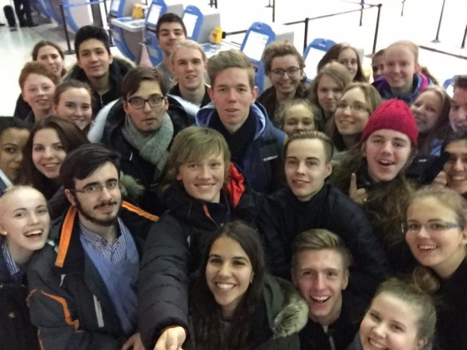
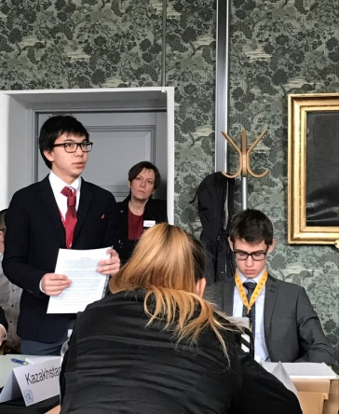
What
Weekly meeting in HOPE groups:
1-2 teachers, 8-24 students
with teachers from different subjects in charge
training debates, planning charity events
becoming a peace mentor at school

Slide 11
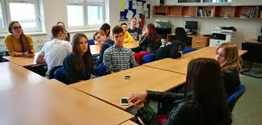
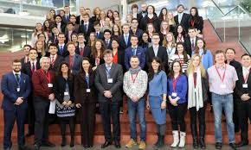
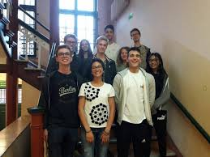
the Clubs

Slide 12
Communication
Youth clubs get and stay connected and exchange ideas and best practices (Whatsapp, Facebook, eTwinning…)
:
:

Slide 13
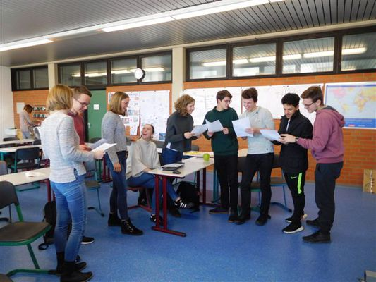
Activities: throughout
Create a club structure, distribute tasks
Logo competition
Battle debates
Local charity events
Preparations for MUNs
Political term topics
Mediation at school (?)

Slide 14
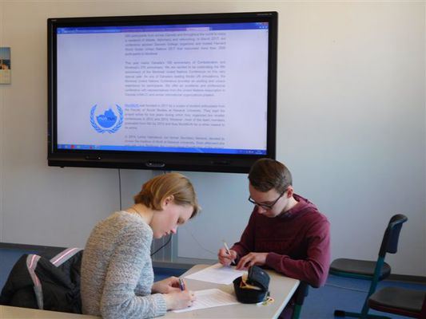
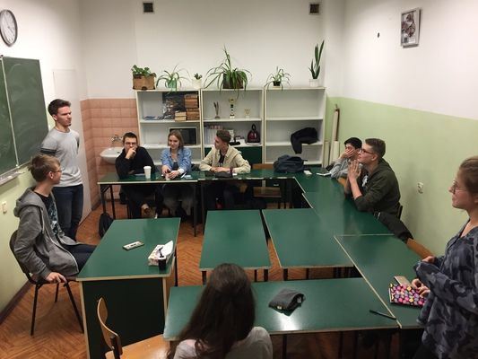
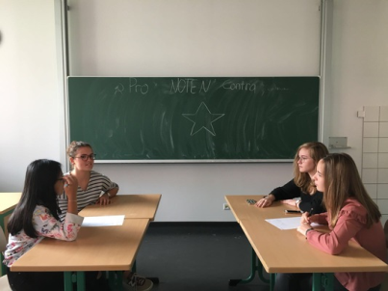
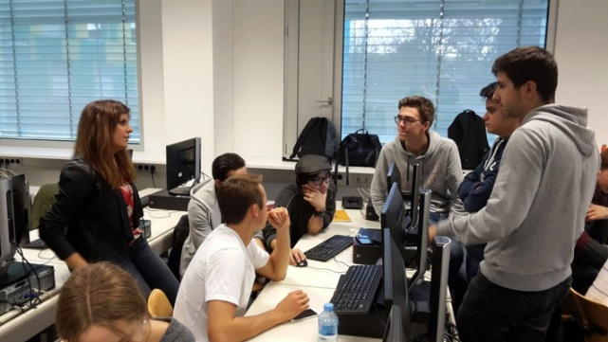
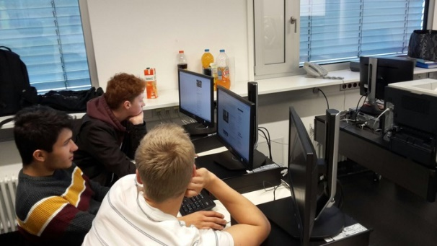
Activities: throughout

Slide 15
Activities: MUNs
Meeting at different MUNs in
Slovakia 2018 and 2019
Poland: 2018, 2019
Luxembourg: LuxMUN 2018

Slide 16
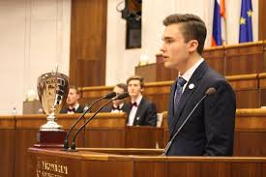
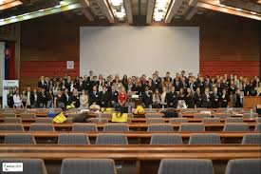
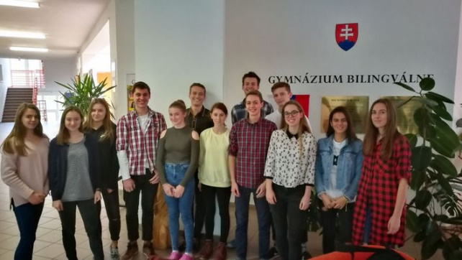
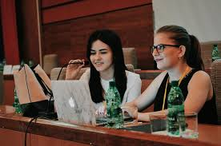
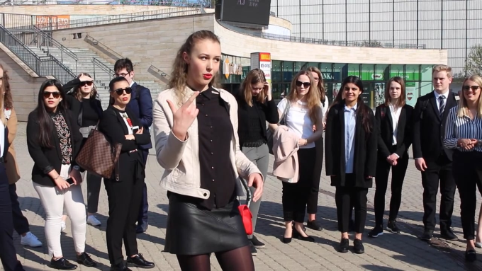
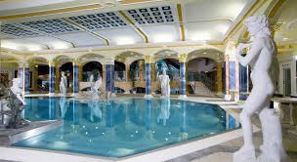
Activities:

Slide 17
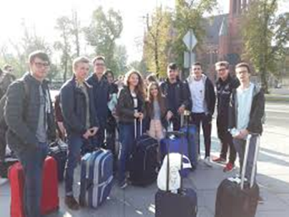
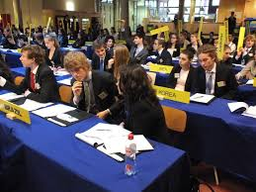
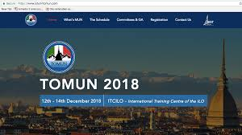
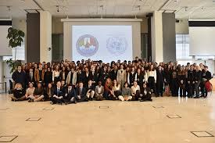
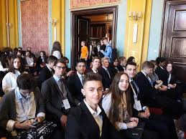
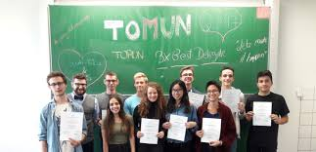
Activities:

Slide 18
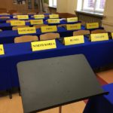
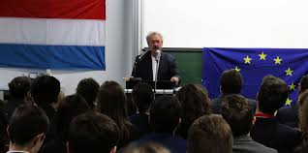
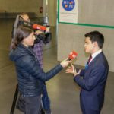
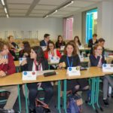
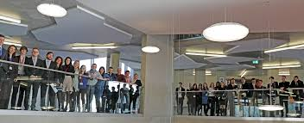
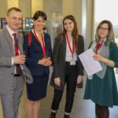
Activities: LuxMUN 02/2018

Slide 19
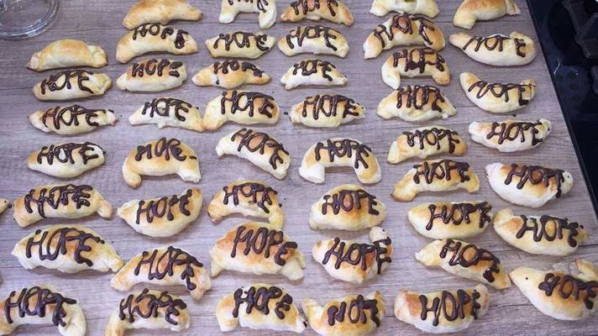
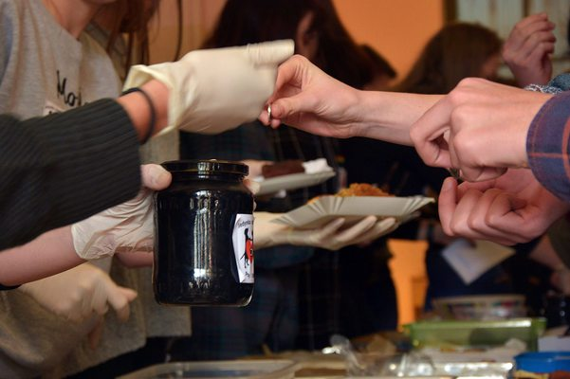
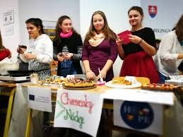
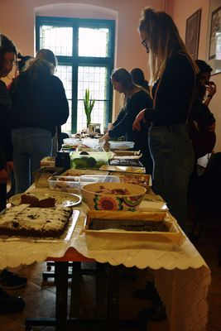
Activities: Charity

Slide 20
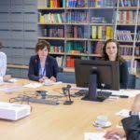
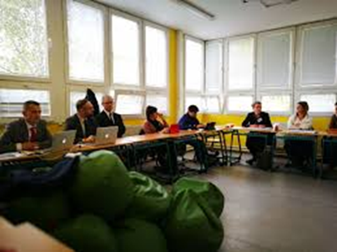
Activities: Mediation
Input from Wittekind Gymnasium and IES Miguel Catalan
Workshop sessions at
ZaMUN and LuxMUN
At LMRL going to be integrated in a Group Bien-Être (=Wellbeing group)

Slide 21
Challenges
Paperwork, reports, Etwinning, NAs
Lack of time, being stuck in daily teaching routine and family business
Local obstacles at school (lack of interest, colleagues who cannot be bothered, jealousy…)

Slide 22
The Big Plus
For students:
Different age groups coming together
Language skills
Rhetorical competence
Cultural experience (staying with host families during MUNs, meeting other HOPE clubs)
Friendships!
Getting more independent
Gaining self-confidence
Good reference for CVs

Slide 23
The Big Plus
For teachers:
Rewarding to see changes at school and in students’ skills
Feeling to make a difference
“coach” for students
solidarity complicity, friendship
fun

Slide 24
The Big Plus

Slide 25
see you All at
MEGALUX
Luxembourg
10th – 14th November 2019

