Slide 1
Second Lyceum of Kalamaria 2018-2020
Title: No Bounds In Learning

Slide 2
Project: No Bounds In Learning
Key Action 2: Cooperation for innovation and the exchange of good practices
Most impacted Field: Strategic Partnerships for Vocational Education and Training
KA202
Main objective : Exchange of Good Practices
Title : No Bounds in Learning (NoBiL)
Duration: 24 months
Coordinating School: TORBALI PIRI REIS MESLEKI VE TEKNIK ANADOLU LISESI – Turkey

Slide 3
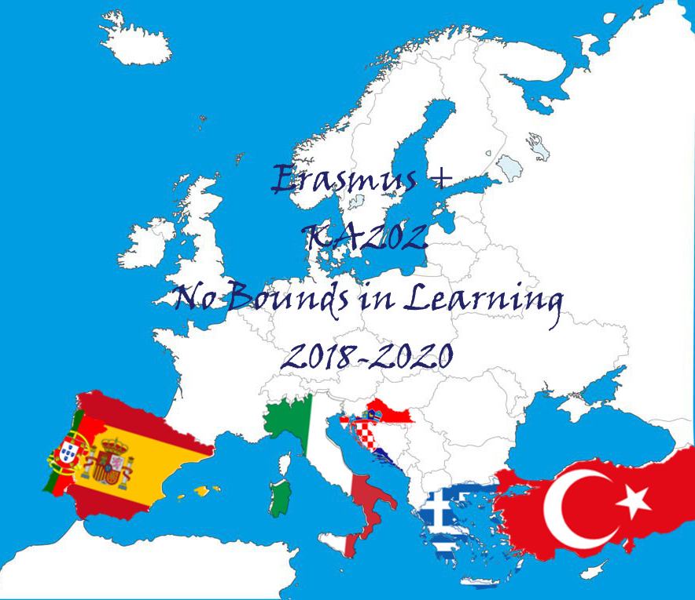
Project: No Bounds In Learning
Participant Schools
IIS Francesco Orioli – Viterbo, Italy
Turisticko-ugostiteljska skola Antona Stifanica - Porec, Croatia
IES BEZMILIANA - Rincón de la Victoria, Spain
Second Lyceum of Kalamaria – Thessaloniki, Greece
Escola Básica e Secundária Dr. Ângelo Augusto da Silva – Funchal, Portugal
Karabaglar Fatih Sultan Mehmet Mesleki ve Teknik Anadolu Lisesi - Turkey

Slide 4
Project: No Bounds In Learning
Our project’s goals:
To contribute to the professional development of personnel that works in VET departments that provide intermediary personnel in service sector (Public Relations, Marketing, Office Management, Logistics).
To improve the quality of planned education for students with learning disabilities
To contribute to the acquisition of basic competences of the vocational education field for students with learning difficulties
To increase teachers’ awareness about training methods applied in Europe and make them capable to develop creative solutions to the problems they experience.
To evaluate the applied teaching methods and experiences in different countries creating a common pool of tools

Slide 5
Project: No Bounds In Learning
Some of the expected results:
Create an effective and functional individualized education plan for the students who have learning disabilities
Analyze the professional needs of students who are trained in the departments that train intermediate staff in the service sector such as Public Relations, Marketing, Office Management, Logistics,
Report the methods and techniques that can be used and carry out effectively in classroom applications
Manage the skills training of students who have learning difficulties according to the individual differences and characteristics of the students,
Create learning environments for students who have learning difficulties

Slide 6
Project: No Bounds In Learning
Some useful details:
We found each other in education portals such as E- twinning and School Education Gateway
The partnership agreements were decided among the schools in the partnership in terms of project experience, reliability, motivation to work on the subject, contribution to the project and their tendency to teamwork and project writing started.
Six of the partner schools with strong international experience.
Very important that we have a special education expert who will train our teachers that educate the students with learning disabilities
We have a multi-beneficiary grant agreement with mandates signed from co-beneficiary schools

Slide 7
Questions ?
Thank you
Ευχαριστώ

