Slide 1



Postojna
SLOVENIA
Europroject Network Conference
17-21 October

Slide 2
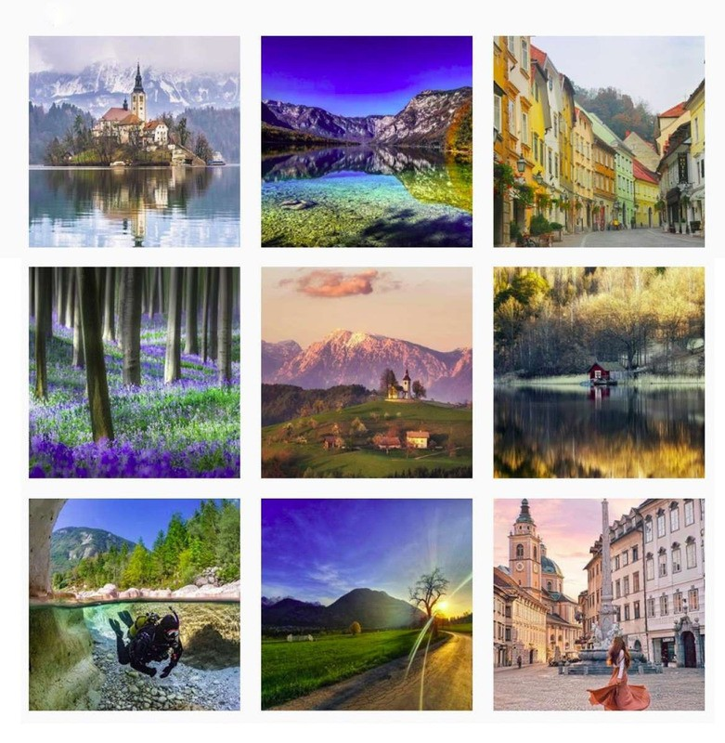
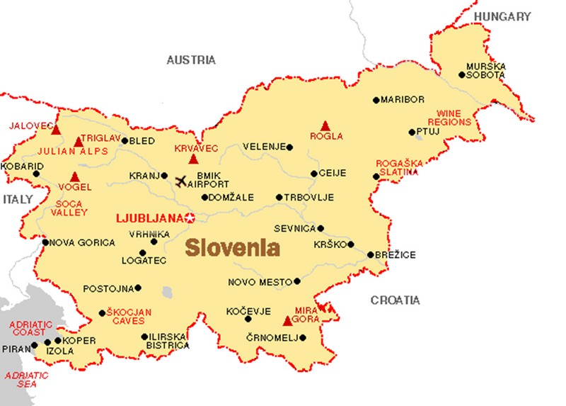
_{S}W_{lo}el_{v}c_{e}o_{n}m_{ia}e to

Slide 3
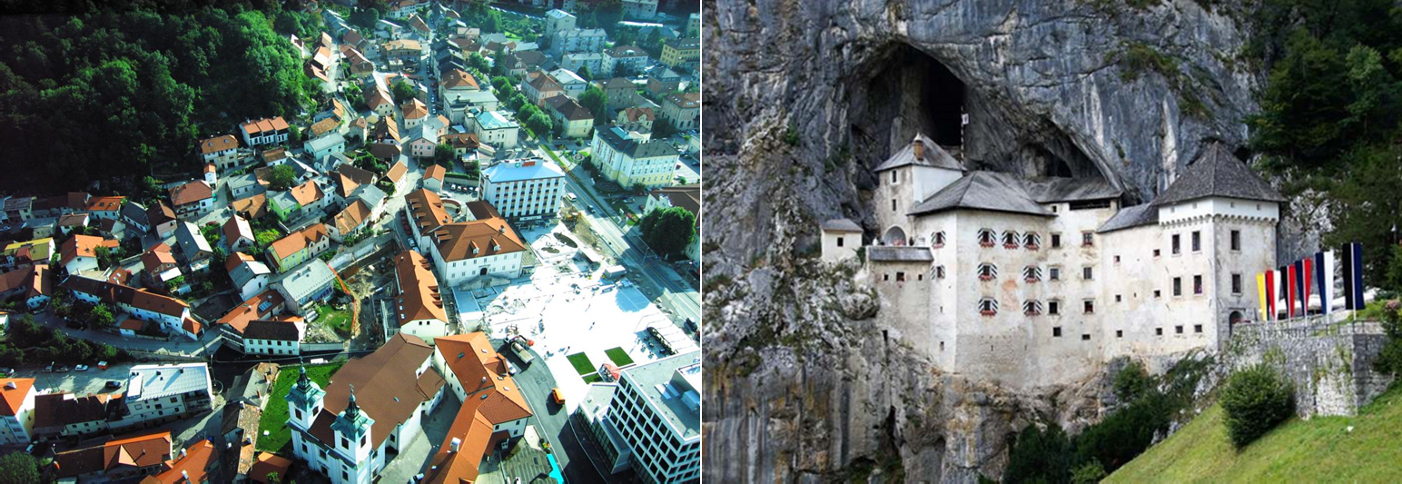
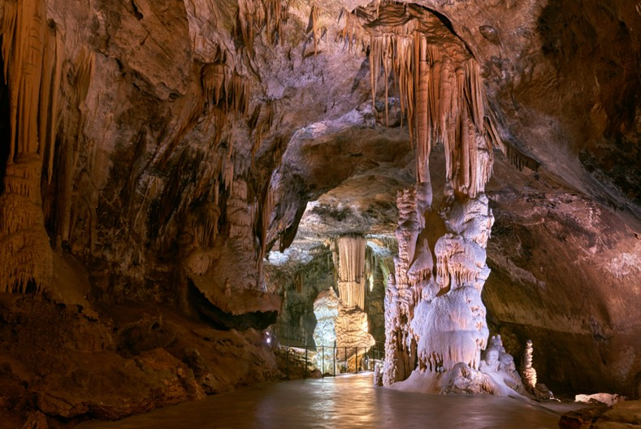
Our home town Postojna

Slide 4


Slide 5










PROGRAMME
TUESDAY, 17 October - ARRIVAL
by car, train, plane NEAREST AIRPORTS:
LJUBLJANA BRNIK, SLOVENIA TRIESTE, ITALY
MARCO POLO VENICE, ITALY TREVISO, ITALY
RIJEKA, CROATIA ZAGREB, CROATIA KLAGENFURT, AUSTRIA

Slide 6
PROGRAMME
WEDNESDAY – Opening ceremony, workshops, visit to Postojna Cave
THURSDAY – Excursion to Ljubljana
FRIDAY - network business / workshops, visit to Predjama Castle, presentations, farewell party
SATURDAY, 21 October - DEPARTURE

Slide 7



Who to bring
2 students age 16-18 2-3 members of staff PARTICIPATION FEE
Teachers in single or double rooms: Single Room 550 EUR p.p.
Double Room 400 EUR p.p.
HOSTEL ROOMS for students 220 EUR p.p.

Slide 8
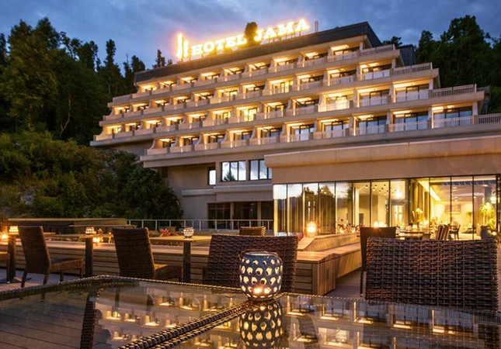
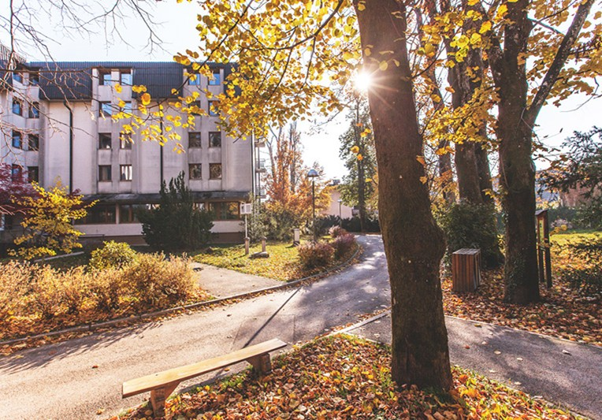
Accommodation
Teachers at Hotel Jama
Students at Youth Hostel

Slide 9
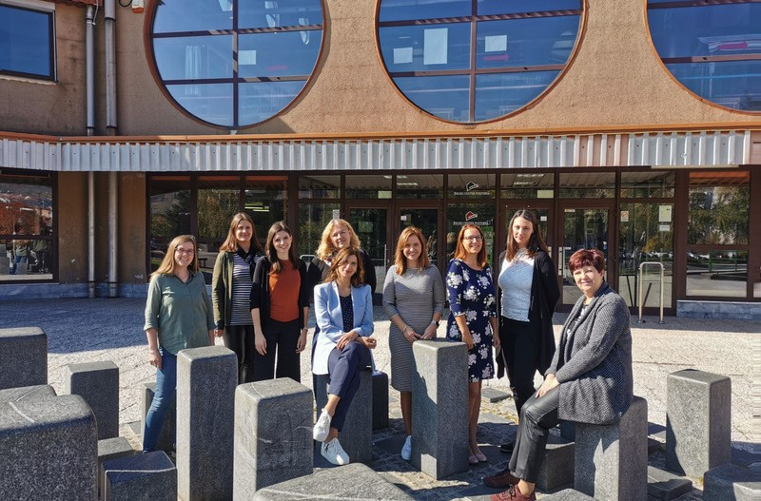
Our dream team

Slide 10
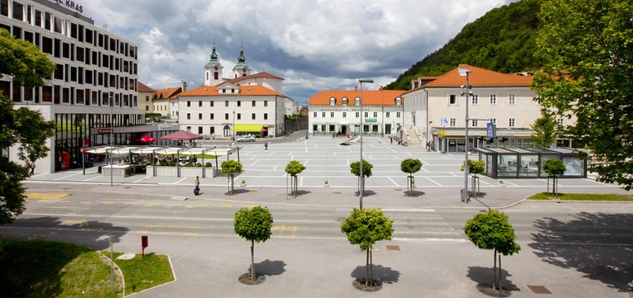
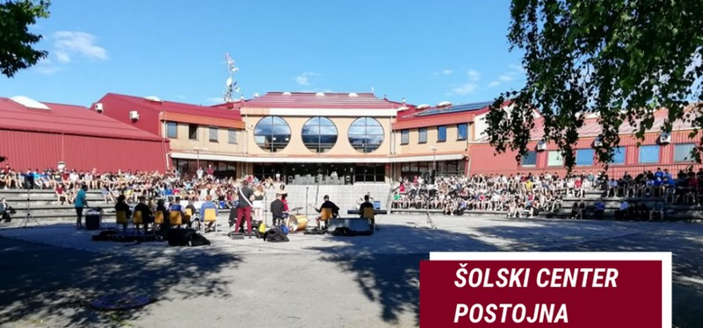
See you in
POSTOJNA :)

