Slide 1

C-side Conference
May 2022
Europroject Team Dendermonde Belgium

Slide 2

Óscar Romerocollege Dendermonde
warmly invites you to our Conference
@ the C-side
in May 2022

Slide 3

After ...
COVID-19
the British version
the Brazilian version
the South African version
the Indian version
...
What is next?

Slide 4
A conference @ the C-side
at the Sea - side
after COVID-19
with some Culture
with some Creativity
with some
sight-C-ing
and some Chocolate on the side
but above all
with the C of ...
with lots of Coffee

Slide 5

Exactly a conference about Connecting!

Slide 6

Connecting Heart and Brain
What happens when heart and brain are disconnected?
Learning and teaching in a POST-COVID WORLD

Slide 7
Program
Wednesday
Every delegation travels to Oostende (easy by train from Brussels Airport and from Brussels-Charleroi in about two hours)
Thursday
Opening ceremony and workshops
Friday
Excursion day: Dendermonde and Gent
Dendermonde
Óscar Romerocollege
Gent
Saturday
Workshops / network business
Outdoor activities in Oostende
Presentation of the workshop results in plenum
Farewell party
Sunday
Departure from Oostende

Slide 8

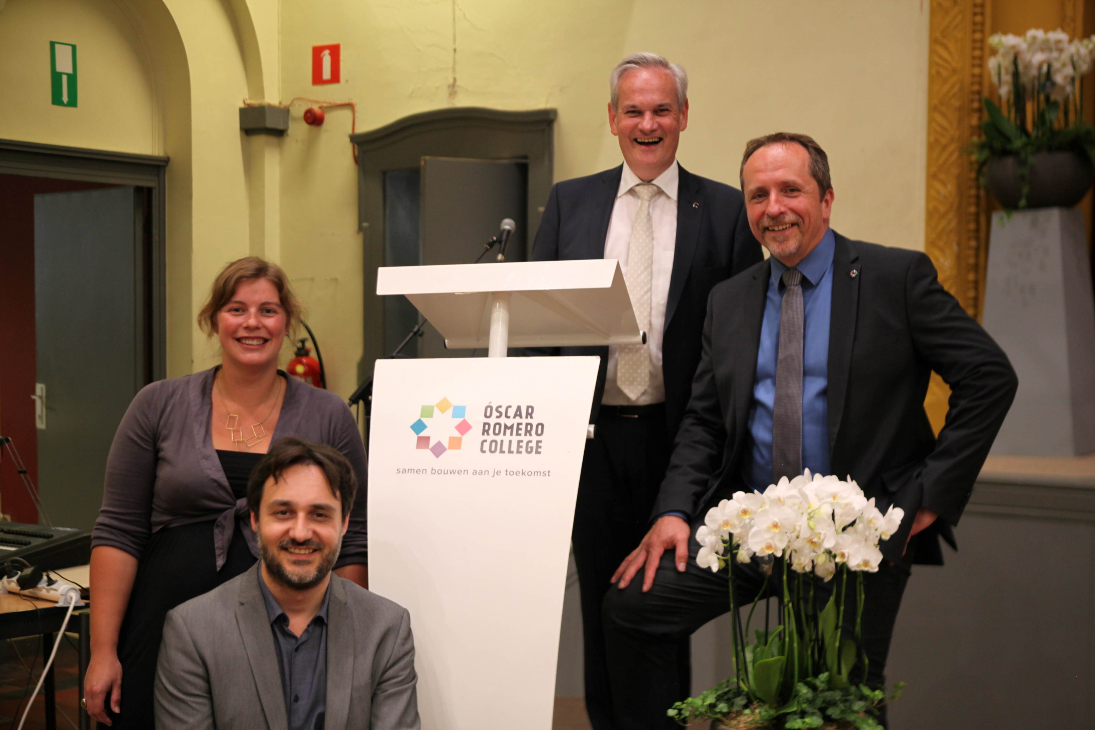

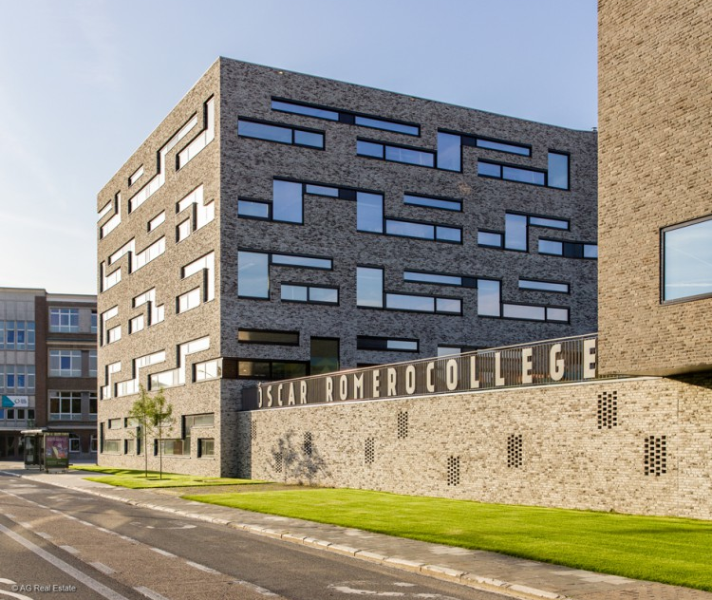
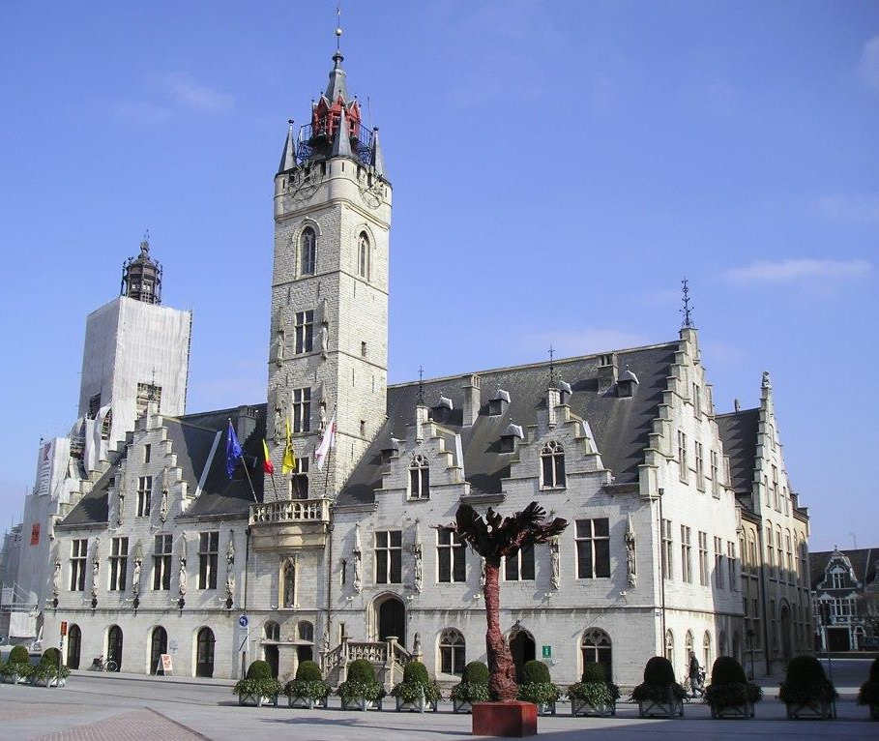
Dendermonde

Slide 9
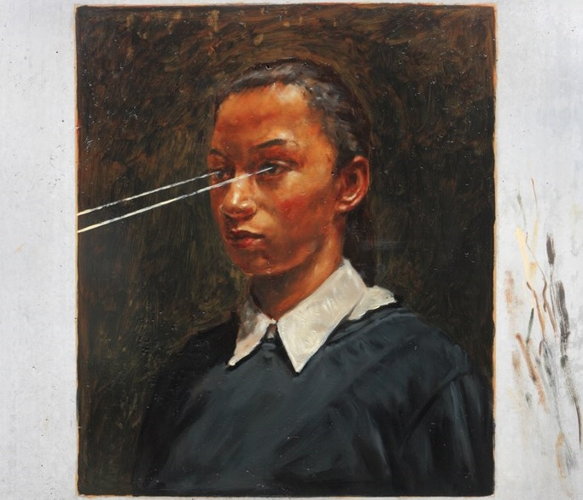
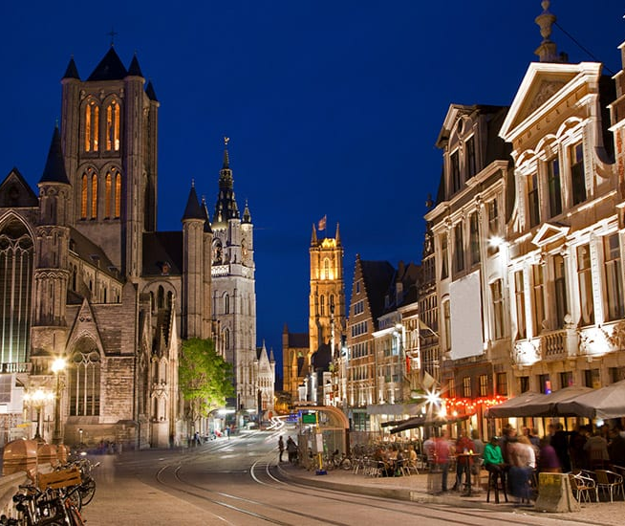

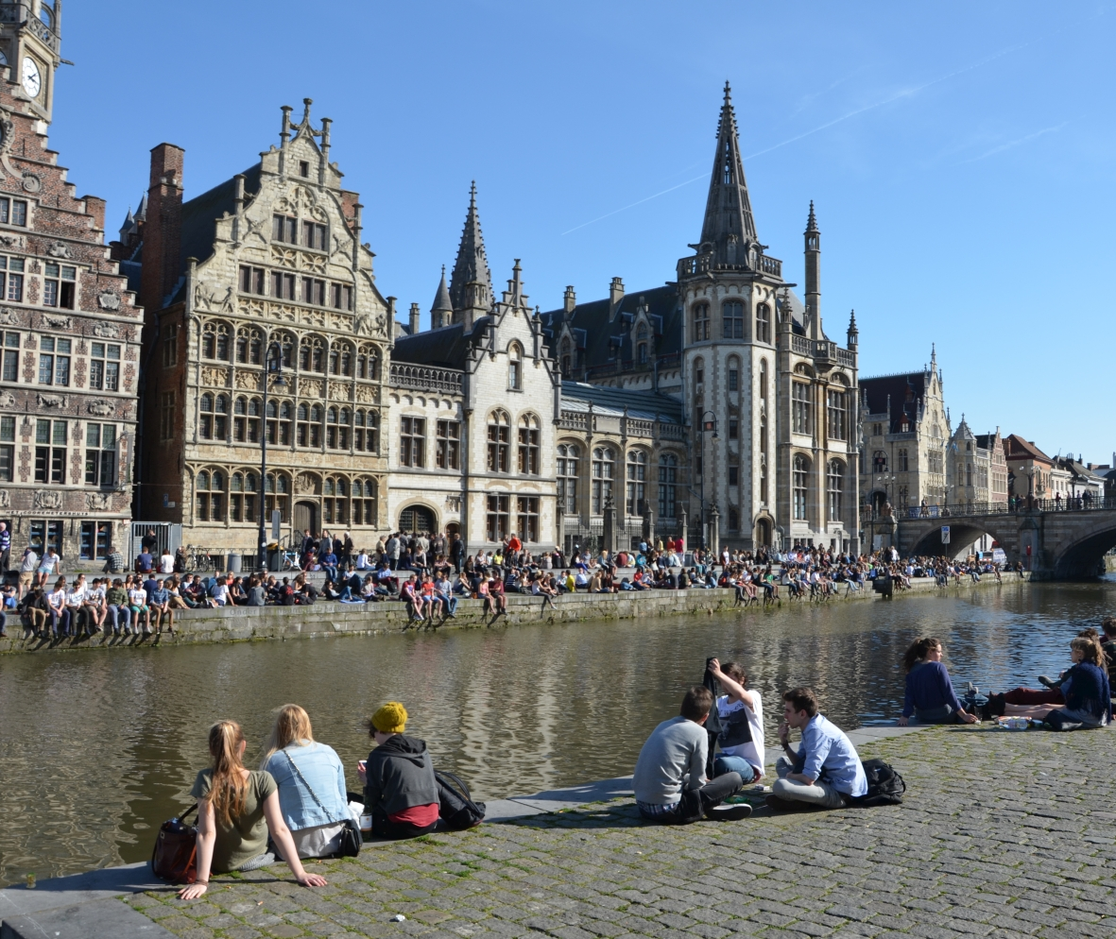

Gent

Slide 10

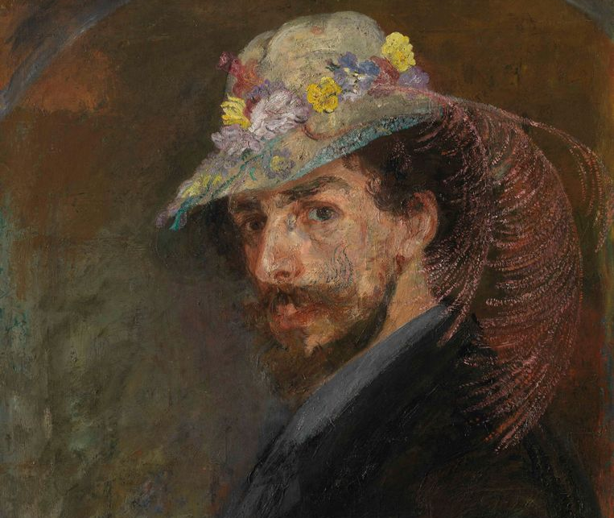


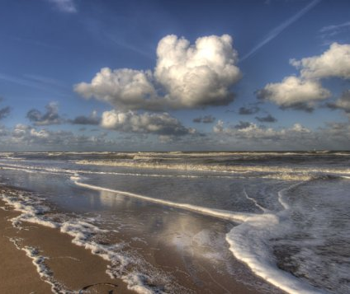

Oostende

Slide 11
Special edition
The students stay with us at the seaside.
Students in apartments of 4-6 persons.
Teachers in single or double rooms.
Price includes all-in formula so a complete catering for students and staff:
  Single Room 600 EUR p.p.
  Double Room 550 EUR p.p.
  Apartments for students 240 EUR p.p.

Slide 12
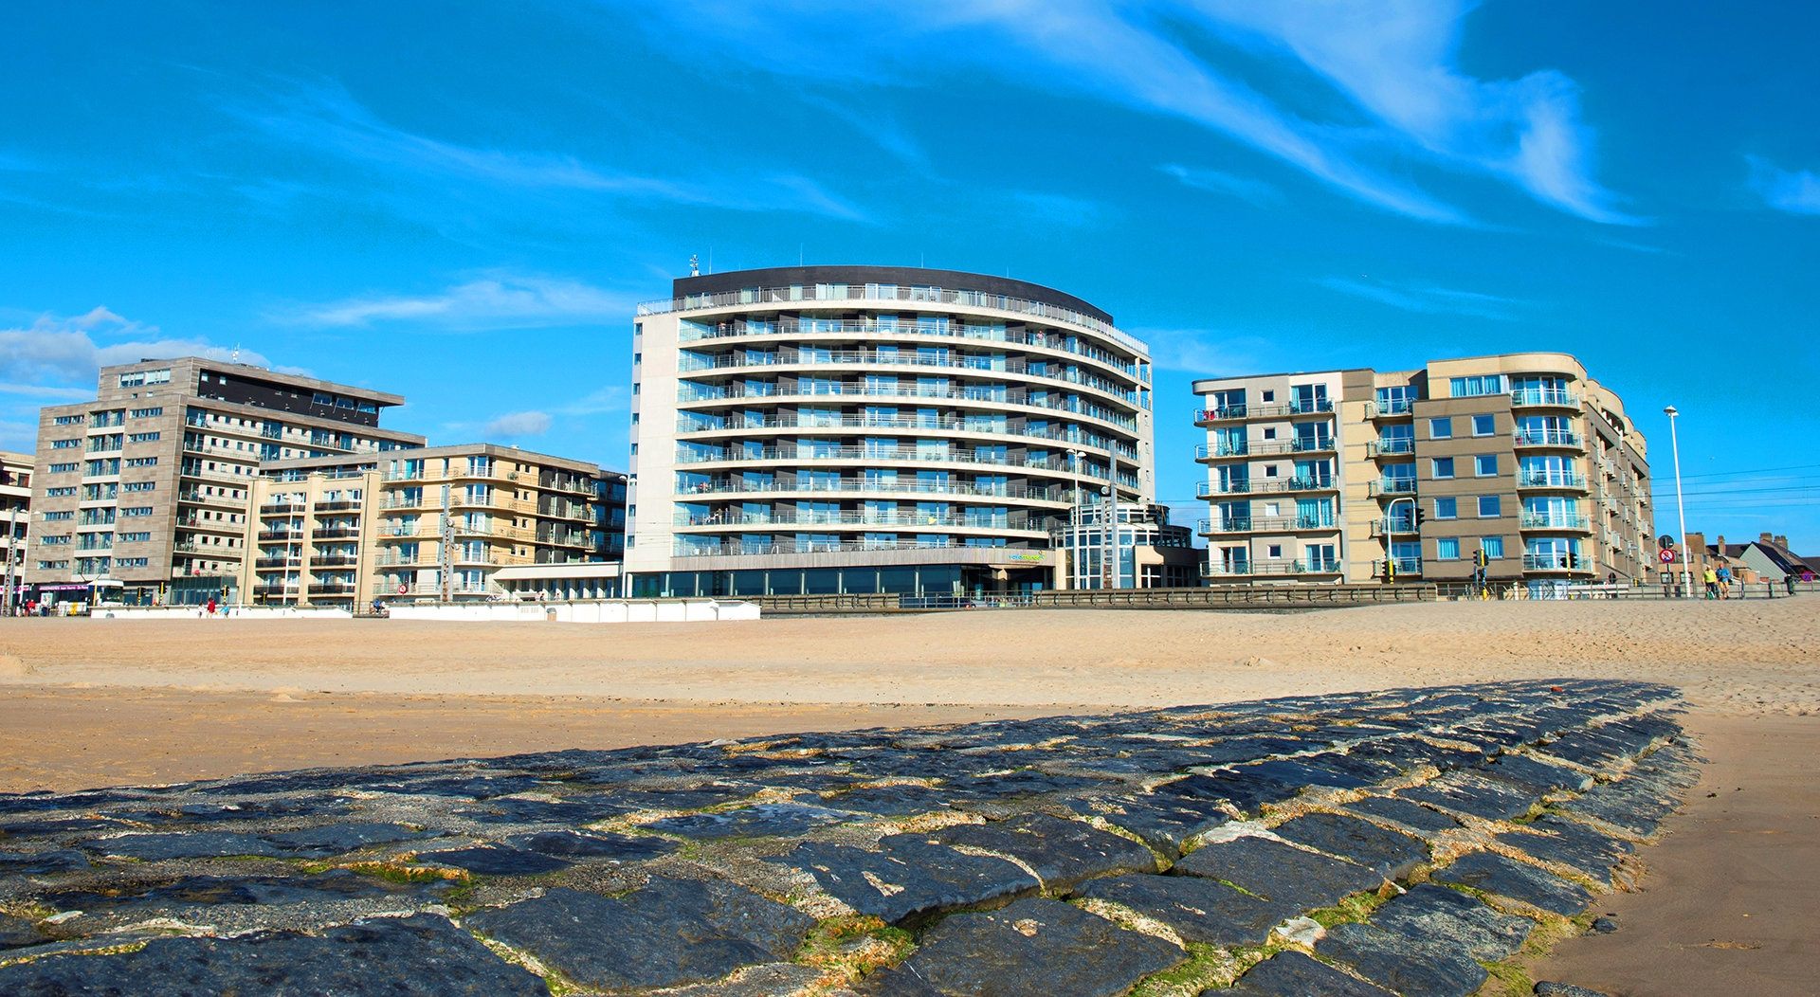

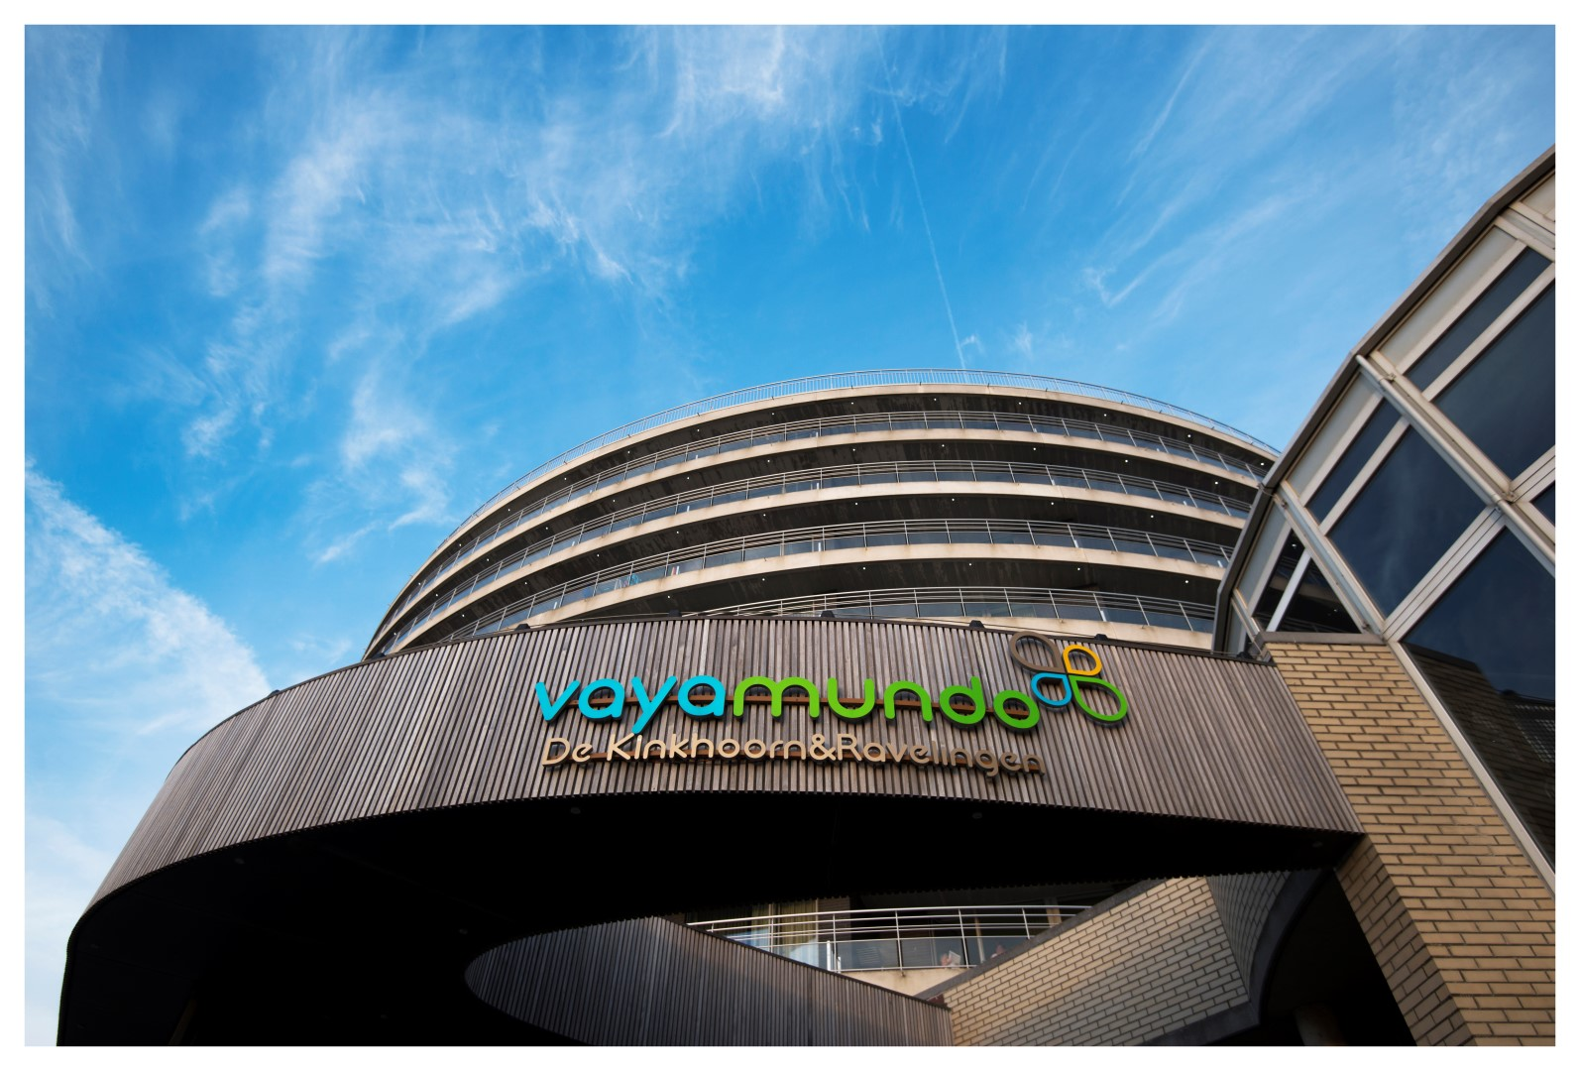
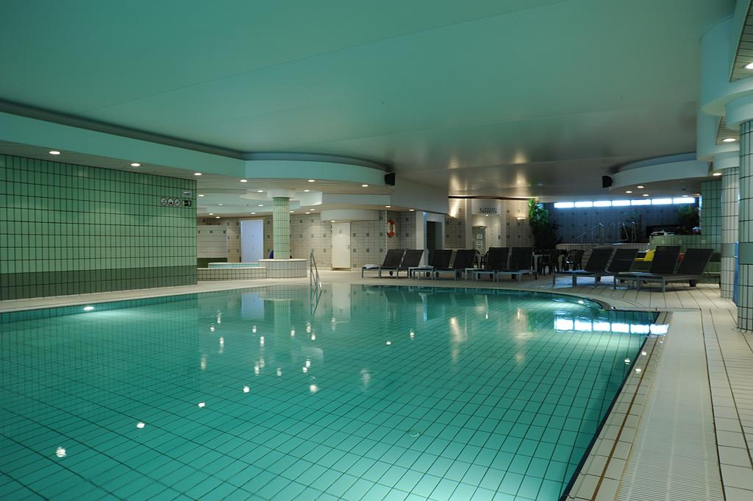
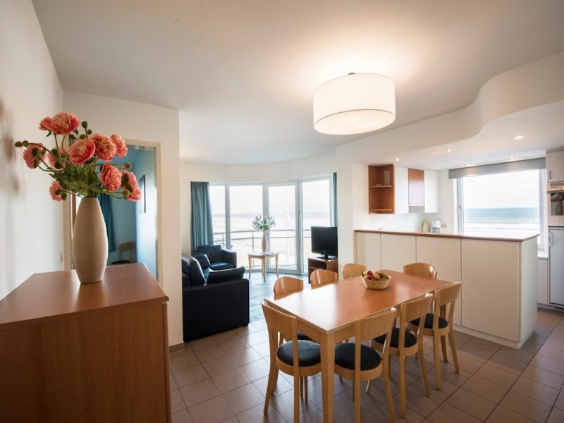
https://www.vayamundo.eu/Oostende

Slide 13
Who to bring?
Who to bring:
  2 students age 16-18
  2-3 members of staff
  All participants must be fully vaccinated and in possession of the EU Digital Covid Certificate. In March we will evaluate the pandemic situation with the Steering Committee.

Slide 14

When?
Wednesday 11/05/2022 arrival in Oostende – Sunday 15/05/2022 departure from Oostende

Slide 15

Looking forward to welcoming you!

