Slide 1
SPRING CONFERENCE
MAY 2013
ARMENTIERES - FRANCE

Slide 2
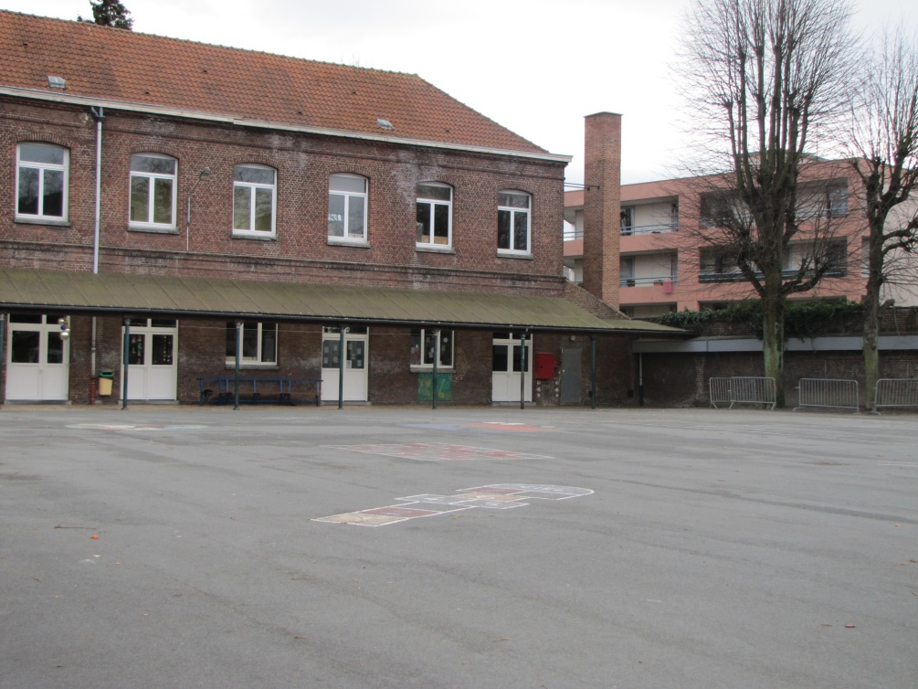
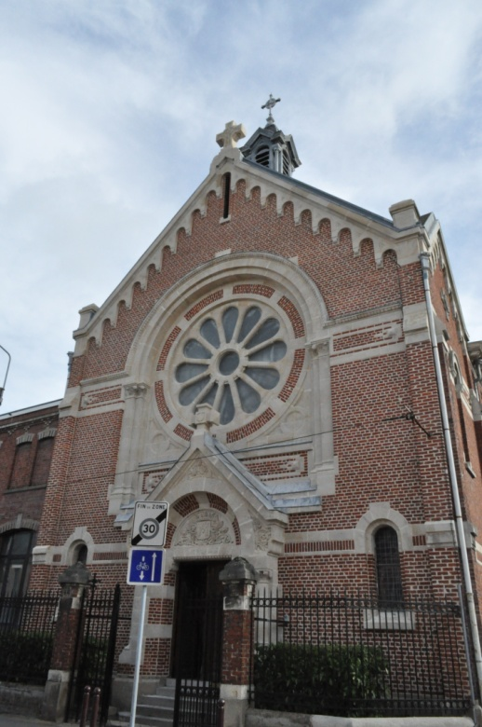
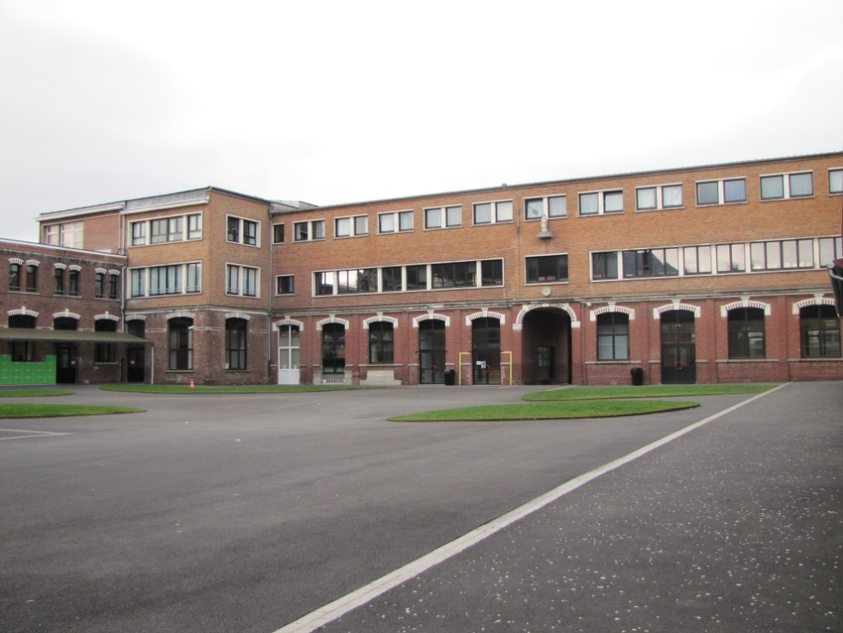
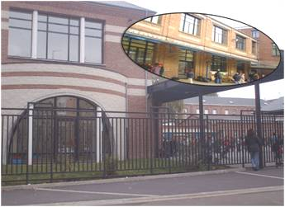
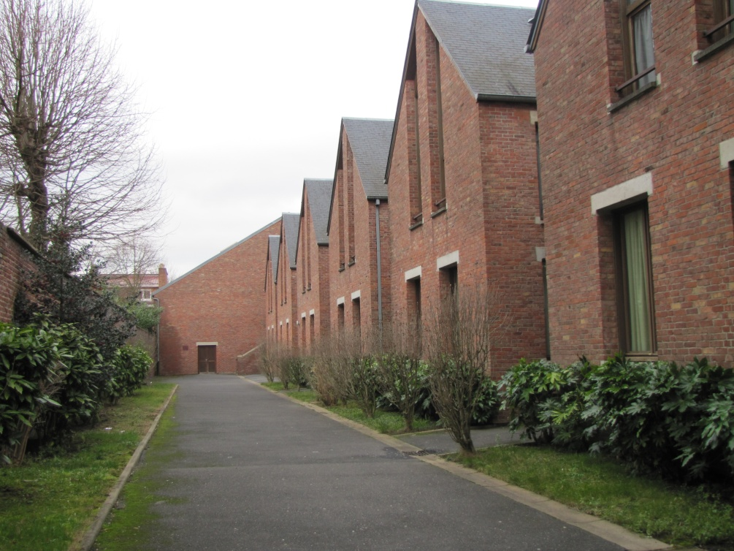

Slide 3
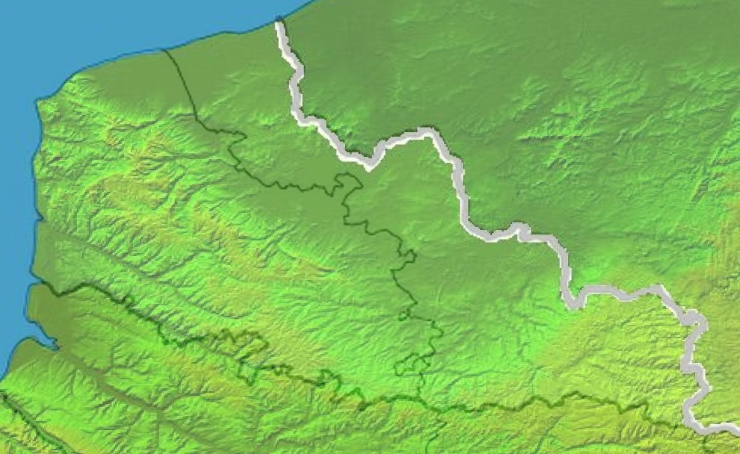
CHANNEL
BELGIUM
Armentières •
• Lille
Armentières is located 25 km from Lille, near the Belgian border. Lille is about 230 km from Paris.

Slide 5
How to get to Lille
Lille can be accessed by means of 4 airports
Lille-Lesquin : we can take you to school and hotel by mini bus
Brussels Zaventen, the nearest railway station to Lille is Brussels-South (15 mins by local railway from the airport). The journey to Lille takes between 40 mins and 1,5 hr)
Brussels Charleroi (ryanair) : we can take you to school and hotel by mini bus
Paris Roissy Charles de Gaulle, then railway to Lille in 50 mins
people from our team will be present at the Lille railway station to take you to school and hotel

Slide 6
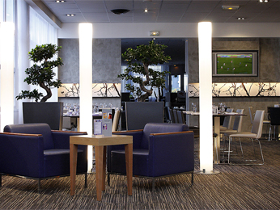
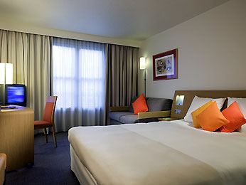
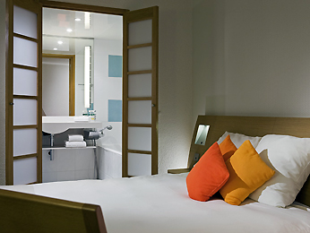
The Novotel Lille Centre is located in the center of Lille, just minutes from the train stations and old city.

Slide 7
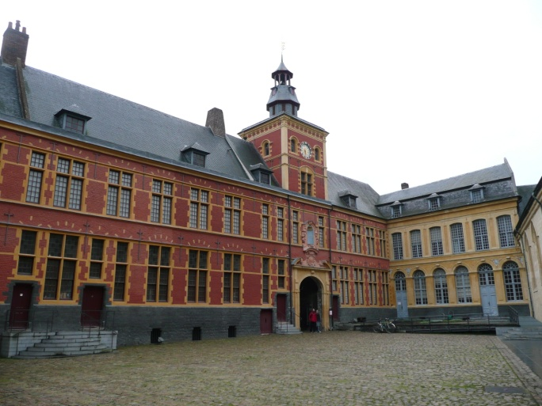
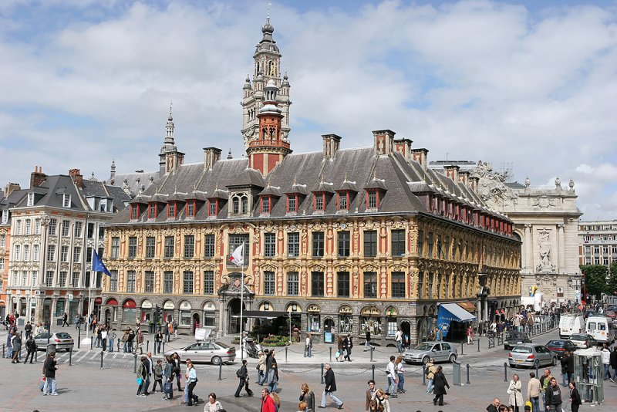
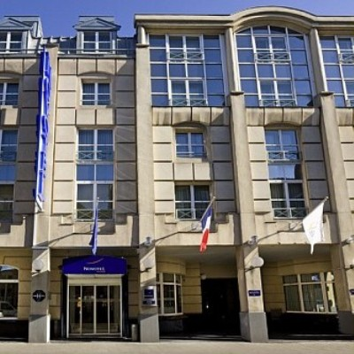
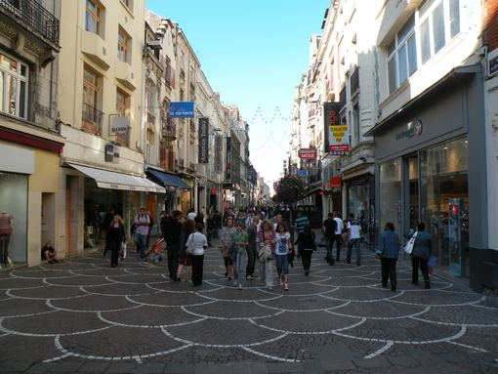
Old city
City center
Hotel
Shopping center

Slide 8
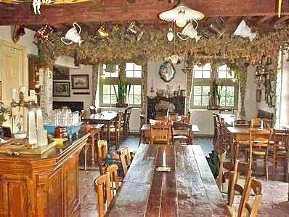
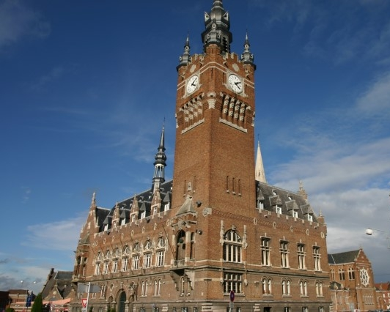
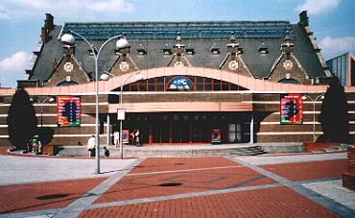

Slide 9
Wenesday 8th | Thursday 9th | Friday 10th | Saturday 11th | Sunday 12th
Travelling day | 9h30 – 10h30 : opening ceremony 11h00 coffee break 11h30-13h presentation of french school system | 8h30 10h30 : working session 3 10h30 coffee break 11h – 13h : working session 4 |  | Travelling day
 | 13h lunch at school | 13h lunch at school
 | 14h : working session 1 15h30 : coffee break 16h00 : working session 2 | 14h -16 h working session 5 Free time
Buffet in the evening in the hotel | 18h30 : dinner in a traditionnel restaurant | 18h museum and restaurant | 17h30 : reception in City Hall of Armentieres 19h00 : farewell party

Slide 10
It will cost 600€ for the room. All lunches (except Saturday one) and dinners as well as all transportations are included.

Slide 11
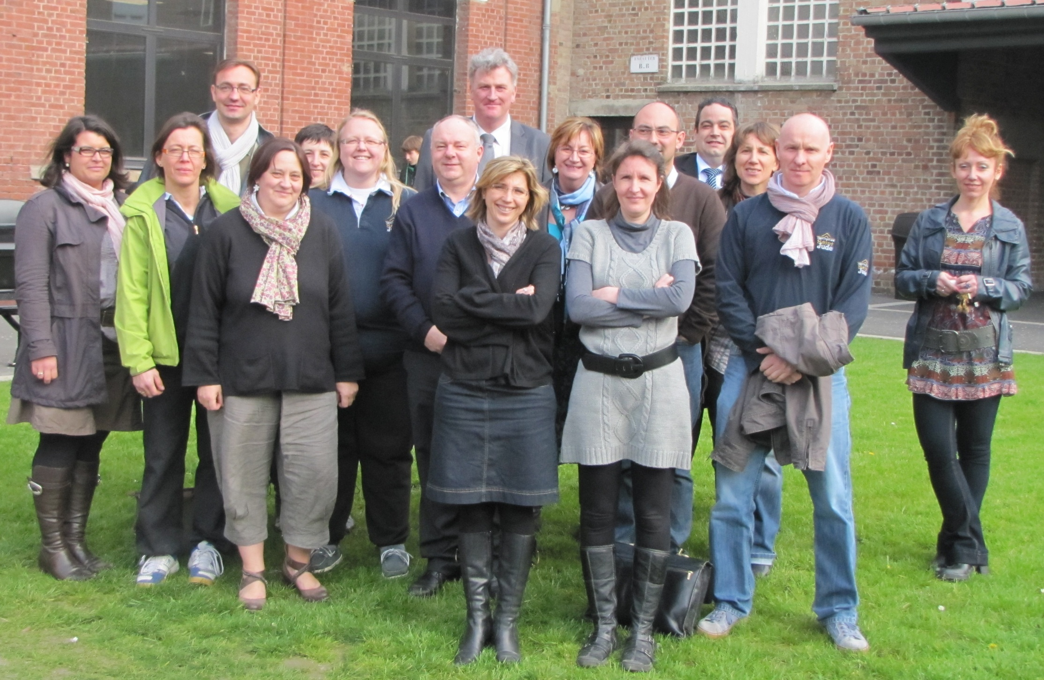
We’re waiting for you

