Slide 1

AD(H)D
Sarah De Visscher
Tamara Verboom
Martin Málek

Slide 2
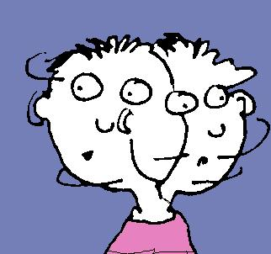
Summary Of the Symptoms :
Easily distracted
Miss details
Daydreaming
Trouble with sit still (impatient)
Talk nonstop
Etc.

Slide 3

Pupil to Pupil : to do
Act normally
Keep calm
When the person in question is very irritating and you can‘t handle it, just ignore
Let the teachers handle it

Slide 4
Pupil to pupil : to not do
Laugh at the person in question
Go into it
Bully the person

Slide 5
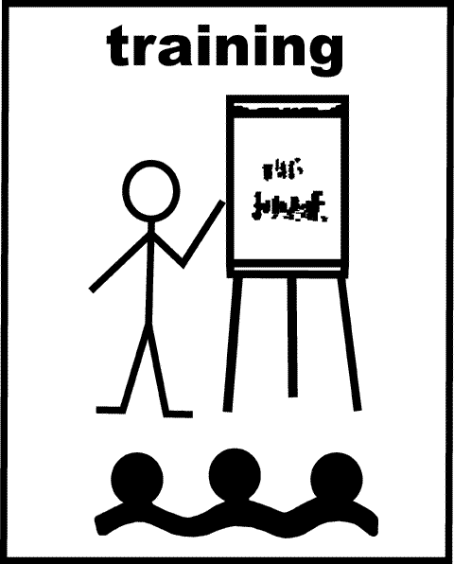
Expectation from Teachers
NOW: a paper with the informations for teachers how to react
IDEA FOR THE FUTURE: Special training for teachers, so the know how to respond immediately

Slide 6
School Strategies
Good:
Involvement of parents
Little breaks
Extra lessons
Special coaching from special person
Shorter assigments/test
Different method of questioning
Separate examination area

Slide 7
School STrategies
Bad:
Alternative work in lesson
Reduced curriculum
Use of laptops
Simplified tests
Extended time for assessements and tests
Different interpretation of the marks
Not penalising students for handle in tasks too late

Slide 8


